Slide 1
INTERNATIONAL CONFERENCE
Internet and Socio-Cultural Transformations in Information Society
Yuzhno-Sakhalinsk, Russian Federation
07–12TH SEPTEMBER, 2013

Slide 2
Socio-Cultural Change
dimension of the Socio-Cultural changes in information society of Pakistan (Developing country) :
the social change includes social contact- staying in touch with family and friends, develop new friendships, quality of life- education-literacy, learning, Health-life expectancy, Poverty Alleviation- poverty rates, Empowerment- freedom, social justice, FREE time, self-fulfillment, self-efficacy.
cultural change is the cultural evolution in the areas change in social behavior, family life, respect for others, addiction for ICT use, fashion design, dressing and trends in other cultural areas due to the internet globalization phenomenon.

Slide 3
Social Change
Kozma (2005) explains the role of ICT in bringing about social change in the following words:
[social development] is the set of broader social changes resulting from the convergence of computers and communication technologies, their assimilation throughout society and their use for communication, collaboration, and the sharing of knowledge. As ICTs—including laptops wirelessly connected to the Internet, personal digital assistants, low-cost video cameras, and cell phones—become more accessible and embedded in society they offer the potential to restructure organizations, promote collaboration, increase democratic participation of citizens, improve the transparency and responsiveness of governmental agencies, make education and health care more widely available, foster cultural creativity, and enhance the social integration of individuals with different abilities and groups of different cultural backgrounds.

Slide 4
ICT Growth Periodic History
ICT Growth
1st Era
1947-1962
3rd Era
1990-2002
2nd Era
1963-1989
4th Era
2003-2013

Slide 5
ICT Growth History

Slide 6
ICT Components/Infrastructure
Mobile Phone | Fixed Lines/WLL | SMS | Internet
Mobile Phone Subscriber 12.7 million 2004-05 with Tele-density 8.30% and grew to 125 million 2013 with Tele-density 70%. The network coverage 90%, covering 10,000 cities, towns and areas. 12.3 Million Mobile Phone imported in 2011 19.2 Million Mobile Phone in 2012 with a growth rate of 64%. | 2.98 Million subscribers Fixed line on May 2013 with Tele-density 1.7% 0.26 Million WLL subscribers in 2004-2005 with Tele-density 0.17% 2.9 Million with Tele-density 1.7% in Sep 2012 | Around 237.58 Billion SMS generated 2011 (P2P) SMS: 236.86 Billion (89.8%) Per day avg. 5.8 P2P SMS 430 Million SMS internationally Revenue around USD 124 Million 2011 A2P & P2A SMS: Revenue 7.4% of the total revenues | Users in 2007: 3.5 Million April 2013 DSL: 2.9 Million 10-15% Mobile Users use Internet Ansr.io report 30M Internet users in PK, around 16% penetration 30% Mobile internet users 80% users spend more than 01 hour/day with average internet session just 5 minutes, which indicates that a user connects multiple times in a day.

Slide 7
ICT Components/Infrastructure
Two TELECOM OPERATORS with landing license
1. PTCL (Pakistan Tele-Communication Company Ltd. (PTCL)
2. TWA1 (Trans-World Association Submarine fiber optic cable system)
five OPTICAL FIBER cable systems connecting the country with the globe.
1. SEA-ME-WE-3 (South East Asia-Middle East-Western Europe 3 Submarine Cable)
2. SEA-ME-WE-4 (South East Asia-Middle East-Western Europe 4 Submarine Cable)
3. TWA 1 (Trans World Associates Submarine Fiber Optic Cable System)
4. FLAG (Fiber-Optic Link Around the Globe)
5. IMEWE (India-Middle East-Western Europe)
Internet BANDWIDTH Of the country is around 260 gb.
nationwide optical fiber systems installed CAPACITY OVER 1000GB, covering over 50,000 km with fiber penetration more than 1047 locations and over 875 cities and towns.

Slide 8
ICT Growth in HEIs in Past 9 years
 | HEIs in 2001-2002 | HEIs in 2011-12
Pakistan Education & Research Network
No. of HEIs connected | 16 | 183
Max. internet bandwidth to an HEI | 128 Kbps | 310 Mbps
Total internet bandwidth available to HEIs | 8 Mbps | 7.2 Gbps
R&E link to other NRENs | Nil | 155 Mbps
Video Conferencing
No. of HEIs provided facility | Nil | 75
No. of interactive events arranged | Nil | 8500+
No. of users benefited | Nil | 8,815
Campus Network established through Development Projects
No. of HEIs having campus-wide network | 10 | 70
No. of Computers (laptop/ desktop) | 5,000 | 66,000+

Slide 9
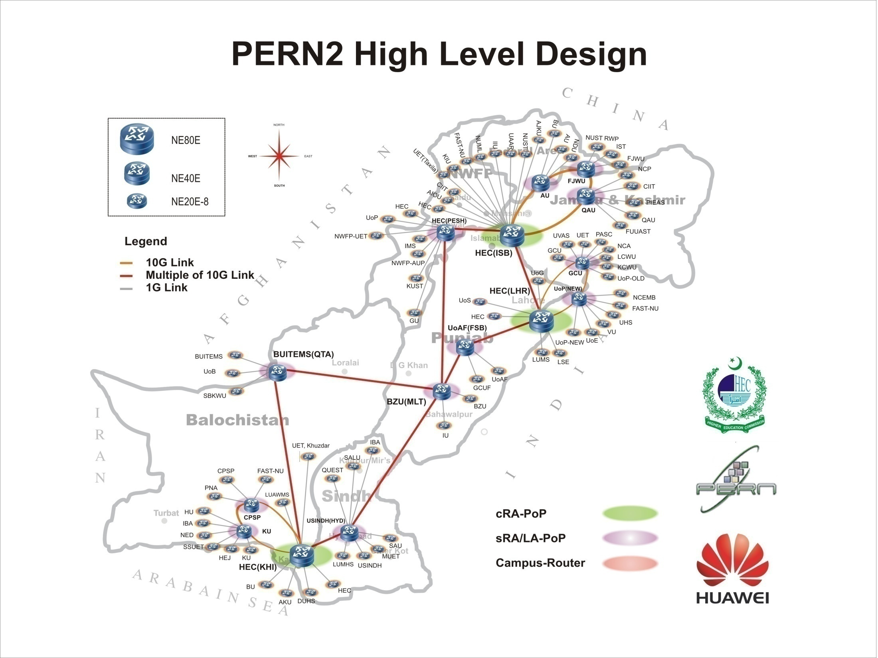
Pakistan Education & Research Network (PERN2)
Fifteen (15) Point-of-Presence across Pakistan
Footprints in forty five (45) Cities
10Gbps metro rings in Karachi, Lahore & Islamabad
7.2 Gbps Commodity Internet bandwidth
1Gbps connectivity to all the Universities/institutes connected to PERN2
155Mbps R&E Link with other NRENs
183 Universities/Colleges Connected

Slide 10
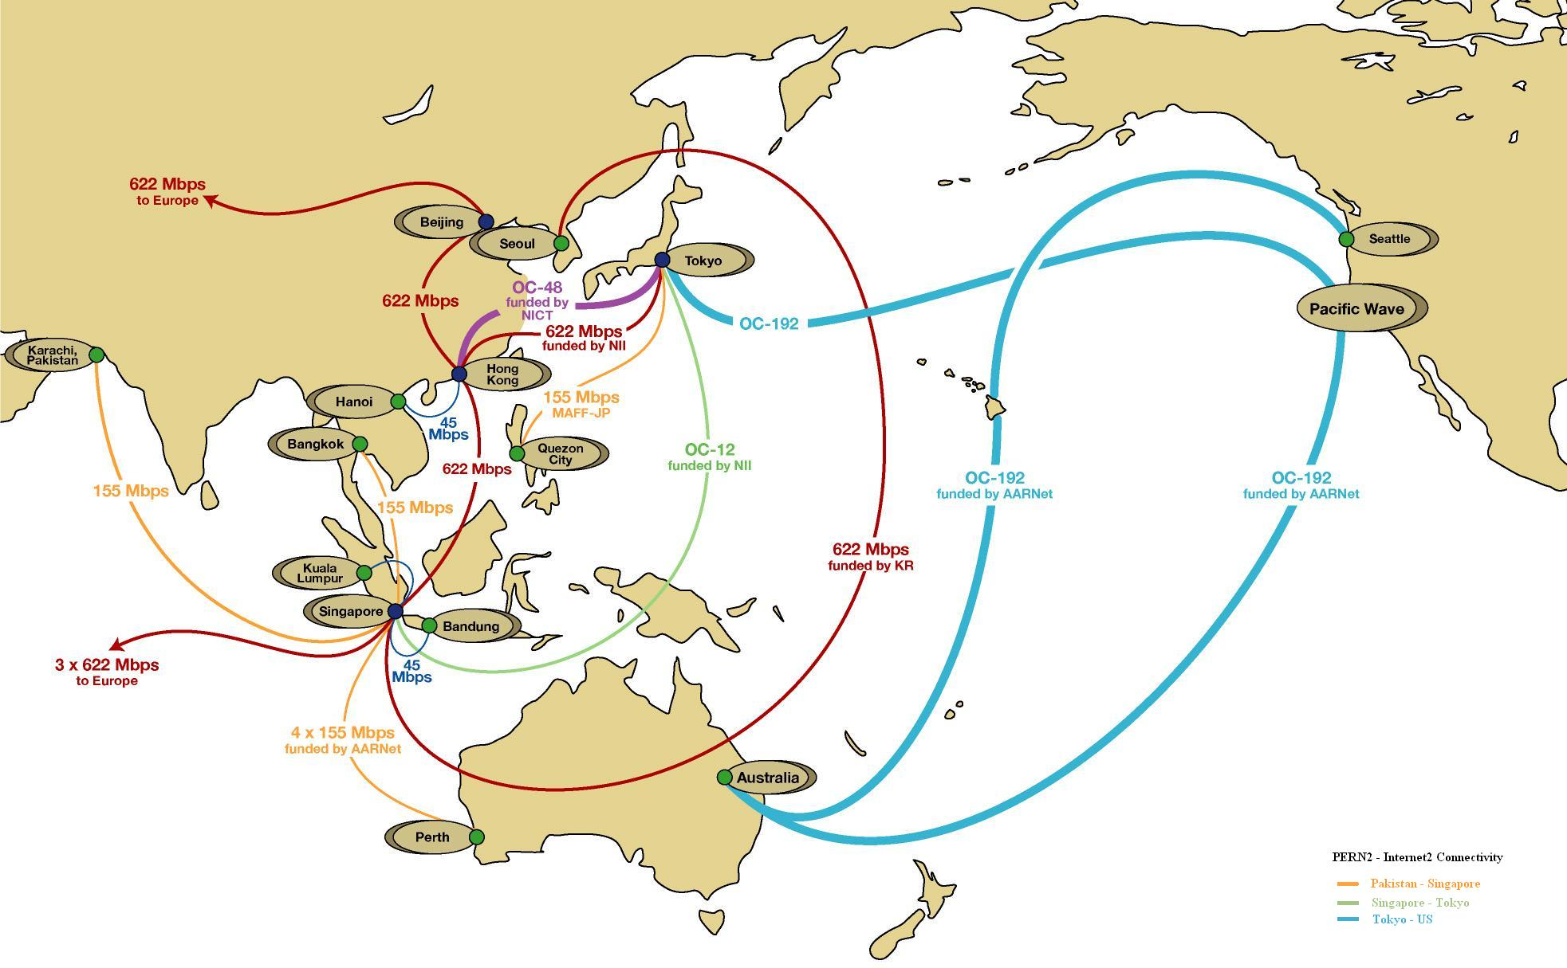
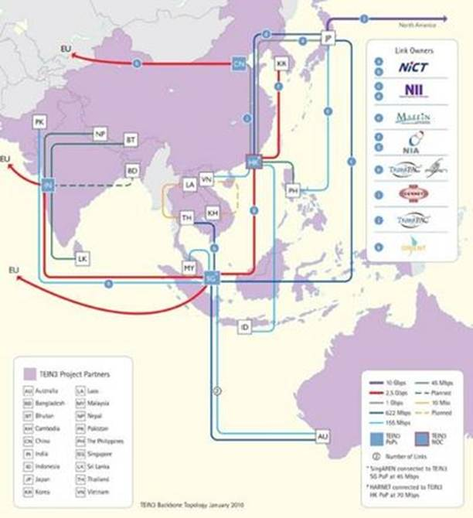
Internet2/ TEIN3/ GEANT2/ APAN Connectivity

Slide 11
Services Offered through PERN
Access to international digital resources
Closed loop secure connectivity
Video/ Voice
Communication Infrastructure
Local contents hosting
Voice over IP across HEIs
Digital Resources
National Digital Library (23,000)
E-Books (45,000)
Pakistan Research Repository
Scientific research, viz. Grids, simulation, computation, etc.
Internet & Intranet
Interactive video conferencing
Unified Comm.

Slide 12
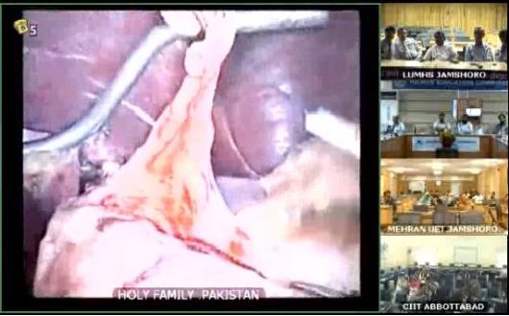
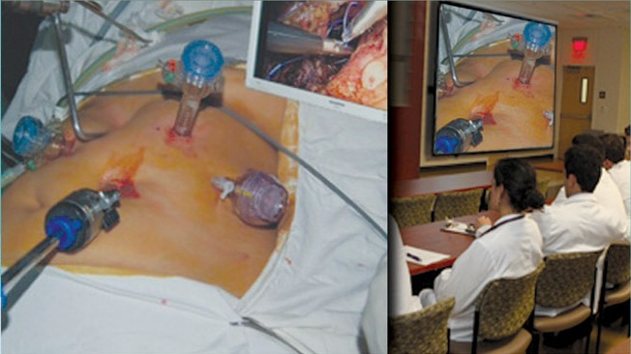
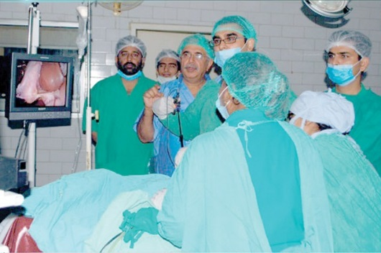
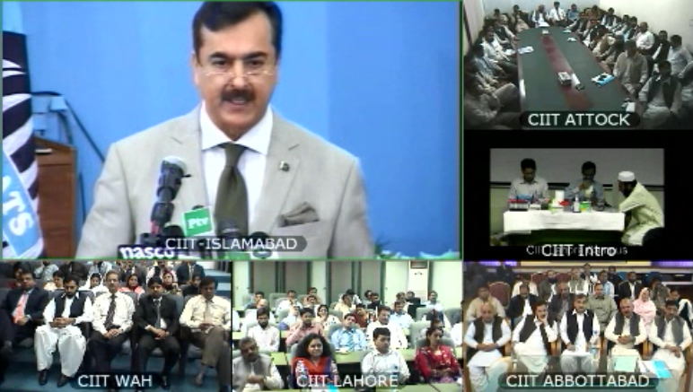
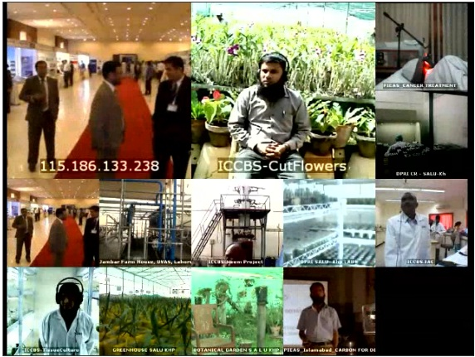
Socio-Cultural Application of ICT
Launched in 2006 and currently 79 sites are under this umbrella network
Virtual Education Program, Pakistan
  Primarily aimed for delivery of lectures, conferences, seminars, workshops, and PhD Defence
Telemedicine
Agriculture Research

Slide 13
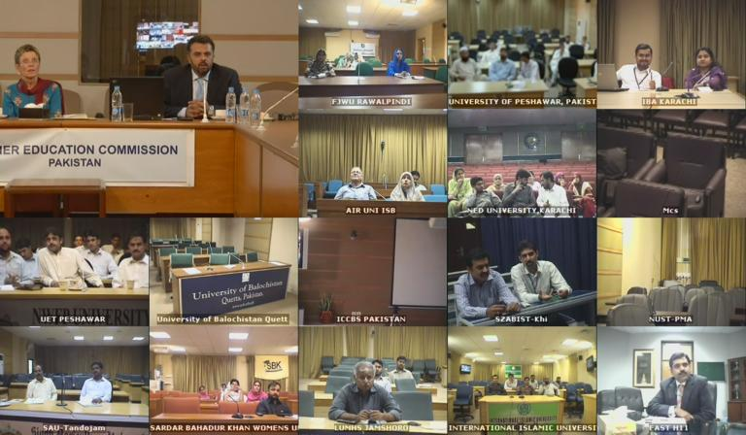
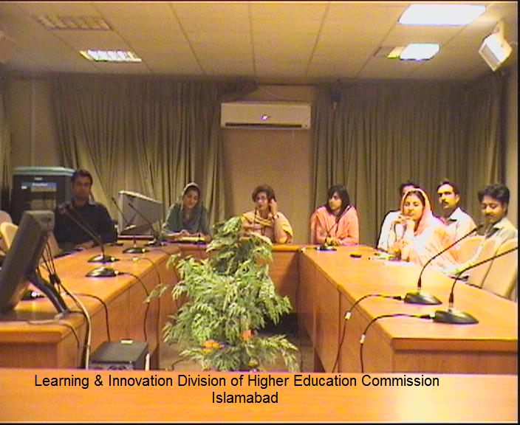
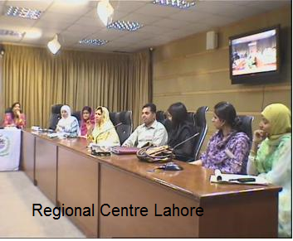
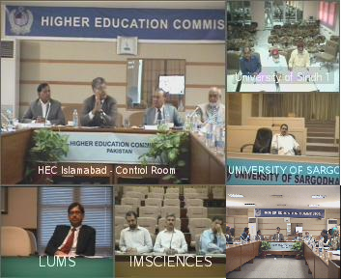
Outreaching for Teaching/ Learning

Slide 14
E-Governance
Online Tax Return (Central Board of Revenue)
E-Academia
E-Government (Federal Govt. Automation)
Transparency
Efficiency
Responsiveness
Accountability
Eradication of Corruption
Equitable & Inclusive
Multi-Biometric National Identity Card
Governance
Multi-Biometric e-Passport
e-LICENSE
Automated Border Control (ABC) system
Automated Fingerprint Identification System (AFIS)
Biometric Verification System (BVS) for issuance of SIM
Automation of Exam. Boards, Universities, other Govt. Organization

Slide 15
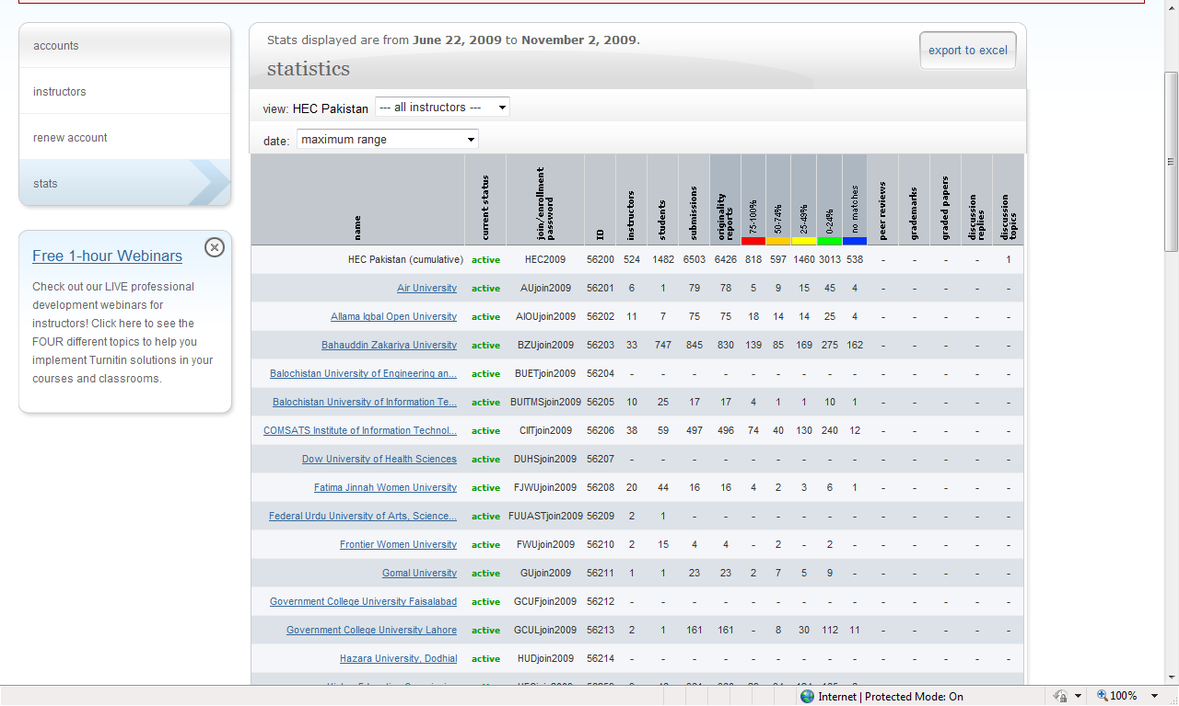
Facilitating Universities to Combat Plagiarism: Access to Turnitin
Indicators | Statistics
Universities/ Institutes provided with this facility | 125
Instructors | 5,503
Students | 25,800
Total Submissions | 207,000

Slide 16
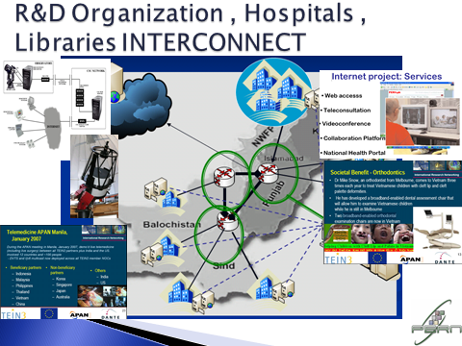

Slide 17
Era | Socio-Cultural Change Over Period Due to ICT Proliferation
1st Era (1947-1962) | Limited movement: People mostly confined to their local or nearby villages, towns or cities, and less inter-provincial movements of people observed. The societies were not well linked. People used available means of transport for travelling or walked to meet and contact their limited social circle or to communicate important messages viz. marriage invitations, death intimation, and other social needs. After the enhancements of postal services, the services were limited to the people lived in cities or towns only.
2nd Era (1963-1989) | During the period 1963-1979, there was no any major change in the ICT facilities. The phone services were found in the main cities and limited access in towns. A change was observed in the 1980s, single phone was found in a locality and the locality where phone existed and in many cases other nearby localities/villages also depended on that single phone. The people were used to make a very important or serious communication through the phone facility viz. conveyed messages related to death, inquiring health conditions of the patients or any other serious matter. Increase in Roads infrastructure and postal services, the communication using letters through post offices slowly increased and reduced the physical travelling by the people for communication purposes. Writing letters and calling through telephone in the society where facilities were available became norm of the society.

Slide 18
Socio-Cultural Impact
Era | Socio-Cultural Change Over Period Due to ICT Proliferation
3rd Era (1990-2002) | Till 1995, people mostly used to and relied on landline telephone and postal services, resultantly the communication and linkage among the people and the society grew considerably. The people used the postal services for exchanging greeting cards on the occasion of religious festival and other events and other communication using letters. During period 1996-2002, people had access on internet; email, internet messaging and a limited segment of society in metro cities had also access to cellular mobile phone service for communication. The trend of communication started changing and the people used sending e-greeting cards through email in place of sending greeting cards through postal services. The email trend also started as supplement to the letter communication by post. The people saw a new hope of future and they felt more comfortable and contented as compared to the previous eras.
4th Era (2003-2013) | This period has bridged the society divide across the country. The people at large now communicate very frequently using Cellular phones, SMS, email, and now using socio media in all walks of the life. The major chunk of communication which made through more formal letter writing in the official and social circles has now been replaced at large extent by simple informal email messaging and SMS text messaging. e-greeting cards through email and greeting messages through SMS and social media are in vogue and largely replaced the traditional way of exchange of greeting cards through postal services. The society at large has accepted these informal email messages and SMS text messages and has become norms of the society at large. The society as whole is now depending on the internet and other ICTs for daily social activities. These technologies have now becoming part of the society and embedded in the lives of the people. A large number of people belonging educated segment of the society use the internet for latest news, knowledge sharing, email, other social activities and entertainment.

Slide 19
Socio-Cultural Changes due to Proliferation of Internet & other ICTs HE Sector
Service Name | Socio-Cultural Impact
National Video Conferencing Empowering Academia & Research Community | Over 8500 online events conducted, through the facility. The resultant change observed in many areas few are mentioned below:
 | People feel empowerment due to 24x7 hours availability of services.
 | Development of social contacts both local and internal community.
 | Promotion to collaborative activities.
 | Brought closer to the Universities as whole.
 | Participation in activities ensured, regardless of space & time barriers.
 | Helping in environmental protection (Carbon Reduction in air).
 | Faculty, Management of HEC and the Universities frequently use facility and avoid travelling long distances.
 | VCs of around 40 Universities linked through Video Conf. on two hours notice across the country to provide input on the GoP Education Policy 2009.
 | Virtual Education Program

Slide 20
Socio-Cultural Changes due to Proliferation of Internet & other ICTs HE Sector
Service Name | Socio-Cultural Impact
Digital Library & E-Books | 23,000+ e-Journals Major Publishers/Repositories IEEE, ACME, EBSCO, Emerald, ACS, JSTOR etc. and 45000 E-Books downloadable
 | Quality and Quantity of Research enhanced due to access on information from reliable sources.
 | 24x7 access to resource, empowers the community.
 | Meets the needs and fulfillment of the community.
 | 24 x 7 access on quality and reliable contests saves precious time.
 | 1947-2001 (55 Years) tot. PhDs produced 3281 & 2002-11 (10 Yrs) total PhDs produced 4850.
 | The Research publ. with ISI impact factors increased from only about 500 in 2002 to 6,250 by 2011 and encouraging trend of applied Res.
 | 6 Pakistani Universities are ranked globally among the top 300 universities of Asia but None was few years ago.
 | Huge traditional libraries are without students, issuance of books minimized, trend of photo copying books disappearing, habit of reading books diminishing from the society.

Slide 21
Socio-Cultural Changes due to Proliferation of Internet & other ICTs HE Sector
Distance Learning | Socio-Cultural Impact
AIOU and VU | 1.3 Million students AIOU & around 65,000 students VU
 | Deprived female students now get education through distance learning.
 | MoU signed for wireless DSL (EVO) with PTCL for 50% discount rates internet, empowerment to socially deprived students especially females.
 | University provides information to 70,000 students use mobile SMS
 | Video Conf. facility at 22 locations and another 22 in process
 | Students registers every year around 6 million online courses, all information is online.
 | Increased trust level and eliminated the man hours and financial aspect which was required in manual system.

Slide 22
Socio-Cultural Changes due to Incorporation of Internet & other ICTs HE Sector
Other Sectors | Socio-Cultural Impact
Health, Judiciary | 03 Telemedicine Centers established by EGD.
 | Pakistan-US collaboration, telemedicine training center established and trained 45 doctors and nurses.
 | Pakistan Atomic Energy Commission established telemedicine center.
 | Some agencies established telemedicine centers to provide treatment and advice to the injured of the earth quack 2005.
 | There is great need of telemedicine centers in the country.
 | Some of the important website that people visit for telemedicine and e-health information are TelMedPak www. Telmedpak.com, Pakmedinet (www.pakmedinet).
 | Public gets their litigation cases information online (web, email, SMS or eKIOSK machines).
 | The communication gap between the litigant public and Advocates are minimized and trust level has increased.
 | The System is currently installed in one province and will be replicated in other provinces.

Slide 23
Socio-Cultural Changes due to Proliferation of Internet & other ICTs HE Sector
Other Sectors | Socio-Cultural Impact
Mobile-Banking, E-Commerce, ATM | A few banks offered mobile-phone banking, used by the customers mostly for pay utility bills and transfer amounts.
 | Most of the mobile money transactions in Pakistan through counter, middle man like a Western Union wire transfer.
 | People can pay their bills at any time to Bank franchise located in their locality. Major portion of bills is now paid through Mobile-banking
 | As per statistics of state bank of Pakistan during the last quarter of 2010, the number of financial transaction made through ATM (32.6m), POS (3.6m), Real Time online Branches (RTOB) (18.2m), Mobile Banking (0.767m), Call Center (IVR) (1.99m) and Internet transaction (0.979m).
 | Due to infrastructure and some security concerns the initiative started late in 2006, only 1-2 banks provide accounts.
 | airlines, Internet service providers, mobile phone companies, and merchants use accounts. The people prefer to use online payments option while reserving airline tickets to save time and extra money.

Slide 24
Socio-Cultural Changes due to Incorporation of Internet & other ICTs HE Sector
Other Sectors | Socio-Cultural Impact
Social Media | 5 Million Ad Marketing on Social Media from Pakistan 30-33% users access Facebook via their smartphone 30% of online population use Facebook Split between male and female is 70-30 2/3 Facebook users are below the age of 25 years More than half of them come from the countries’ richest 10% of the households Facebook around 9 Million, Twitter 2 Million, LinkedIn 1.2 Million, Arrow 1.4 Million
 | The youth of the country supporters of Mr. Imran Khan politician ex-captain of Pakistan Cricket ran the election campaign on Facebook.
 | OLX Pakistan, the buying and selling portal, continued its growth and it has crossed the 1.92 million fans mark in Pakistan out of total 2 million
 | Intel is the 2nd most liked brand on Facebook in Pakistan with a total 1.4 million local fans
 | Nokia Pakistan is the third popular Facebook page with total 1.39 million local fans;
 | Ufone is the 4th popular Facebook page in the country with 1.3 million fan base.

Slide 25
Socio-Cultural Changes due to Incorporation of Internet & other ICTs HE Sector
Other Sectors | Socio-Cultural Impact
Other Areas | 50 Million voters verified their polling station during the election 2013.
 | 39.5 million male and 12.3 million female voters . 29.2 million voters between the ages of 18 and 35-years, Over 10.4 million people belonged to the 36 to 46-year age, 6.7 million from 46 to 56-years age 4 million voters from the 56 to 66 age 1.5 million from the age of 66 and above. Around 28.8 million voters from urban areas and 23 million voters from rural areas.
 | National Income Support Program will disburses around USD 700 Million 2012-13, to the needy people who are below the poverty line, disbursement is made through ATM card and SMS message. People feels empowered when really receive the message.
 | Participation of deprived society members especially females is ensured by the ICT.

Slide 26
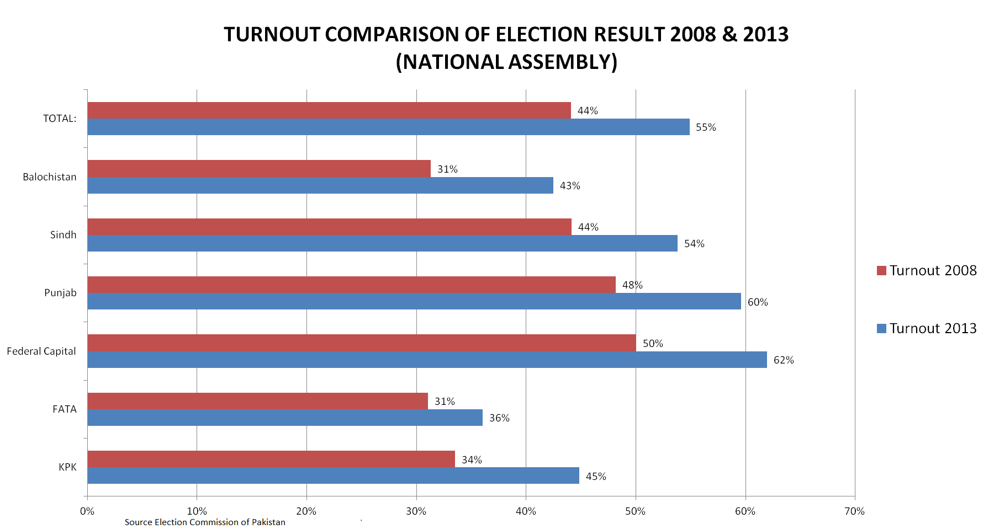

Slide 27
Socio-Cultural Changes due to Proliferation of Internet & other ICTs HE Sector
Other Sectors | Socio-Cultural Impact
Other Areas | Local Language Scripting threat
 | Internet has broaden the limits of Family life privacy
 | The culture of village pubs/sitting area finished
 | Globalization phenomenon changing the culture
 | Number of bomb explosion in the Pakistan made during last few year where ICT driven.
 | Use of Mobile phone networks by the criminals a big threat to the country.
 | Newspapers (Print Media) reading culture is reducing and some extent demising slowly from the society.
 | Wrist watch culture is also diminishing fatly from the society
 | Clock timer culture is also diminishing from the society, people use mobile phone alarm.

Slide 28
Thanks!

