Slide 1
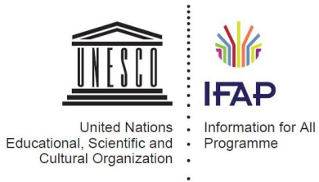
From Cultural Consumers to Cultural Prosumers: Co-creation of Cultural Changes in Information Society
Dr. Susana Finquelievich
National Council for Scientific and Technological Research – CONICET, Argentina
International conference
Internet and Socio-Cultural Transformations in Information Society
September 8 -12, 2013, Yuzhno-Sakhalinsk, Russian Federation

Slide 2
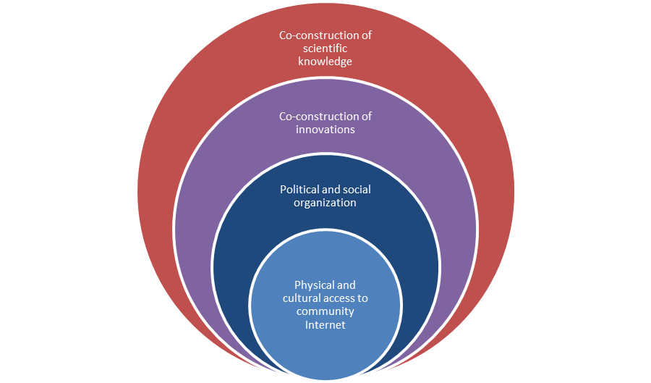
From ICT use to the co-creation of scientific knowledge

Slide 3
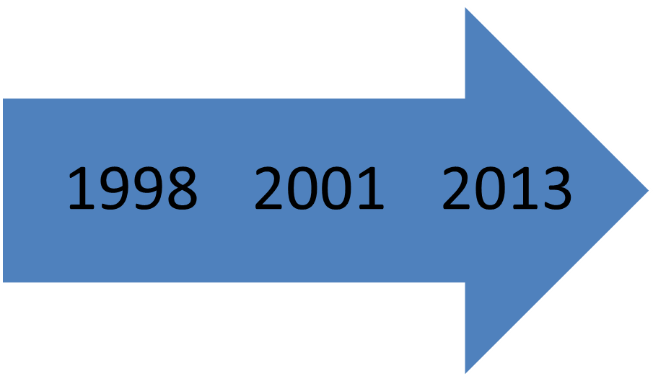
Four case studies:
Citizen´s appropriation of ICT for community empowerment
Political participation through ICTs
ICT productive appropriation and co-creation of socio-technical innovation
Co-creation of scientific knowledge

Slide 4
1. CN: the first widespread attempt to develop networked ICT for community affairs
Community computer networks thrived around the world in the 1990s
They served a diversity of purposes: making the Internet accessible to communities, developing economic opportunities in disadvantaged communities, empowering communities in order to play an active role in local and global political agendas …
They provided empirical concreteness to the concept of civic intelligence

Slide 5
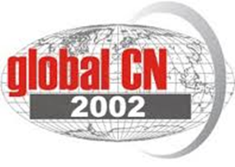
The Global Community Network Partnership (GCNP). 1998 - 2003
BCNet, the Barcelona Community Network, promoted the GCNP in 1998
Primary purpose: to learn and to share the ICT-enabled and online practices that contribute to the formation and on-going health of communities
Vital commitment to the uses of ICTs for social change
“Internet-based” or community online view of socio-economic development

Slide 6
A brief but fruitful life
GCNP promoted the development of ICT, organization and content: new media, new schools, and new democratic participation schemes
GCNP succeeded in:
  Putting in place the best experiences on CN worldwide
  Networking CN leaders
  Providing periodical international visibility to the movement
  Promoting local, regional, and national CN organizations
  Reach significant social actors in nearly 30 countries
  Place the concept of community empowerment though the Internet in national and international agendas

Slide 7
2. Political participation through ICTs: Citizen Assemblies in Argentina
December 2001: A financial crash destroyed Argentina´s financial system
December 19th: the President declared a State of Siege
Thousands of indignant citizens filled the streets clattering their pots and pans in one of the first “cacerolazos”
It was the first of many citizens’ public manifestations.
A powerful social explosion that caused the abdication of four successive Presidents in a single week
A new outburst of citizen information powered by ICTs

Slide 8
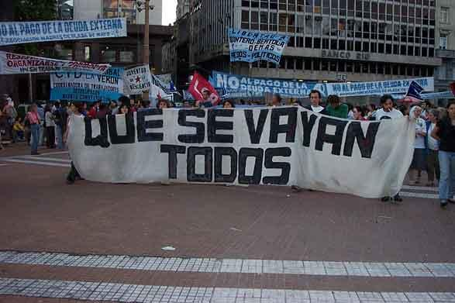
From cyberspace to the streets

Slide 9
First organized by telephone or hearsay, demonstrations were orchestrated via the Internet
Neighbors in Buenos Aires and in the largest cities began to assemble in street corners, cafés or neighborhood clubs
They met several evenings a week to discuss “proposals for a new Argentina”
They started electronic forums to continue their debates and inform those not at the meetings
They designed websites to spread word of their actions and proposed projects
Gradually, different neighborhood assemblies – 112 in Buenos Aires City and 105 in Greater Buenos Aires – were communicating among themselves
In two weeks, inter-neighborhood Sunday meetings were formed, whose actions and decisions were reported through its websites and electronic newsletters

Slide 10
The anti-globalization model
The popular assemblies in Argentina modeled their IT-based organization on the anti-globalization international movement which had started in Seattle in 1999
Ideologically, however, they were unrelated
The Argentine movement was solely aimed to mobilize national and international public opinion concerning the financial/political situation in Argentina
“Cacerolazos” and other popular assemblies were also held outside the country, by Argentines in various European countries, UUSS and Australia

Slide 11
A collective MIL experience
A direct cultural impact: reinterpretation of official media information
Social appropriation and dissemination of the Information Society tools, once available only to the élite
As a consequence of the Assemblies, many young people joined political movements, using ICTs tools (social networks, internet radio stations) to organize diverse groups, disseminate ideas, and combine the use of public space and cyberspace for social mobilization

Slide 12
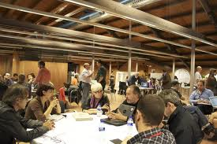
3. Co-creation of innovation: Living Labs
A Living Lab: a user-centred, open-innovation ecosystem often operating in a territorial context
It integrates concurrent research and innovation processes within a public-private-people partnership
They usually imply the participation of several social actors: the State, universities, and citizen organizations
Quadruple Helix

Slide 13
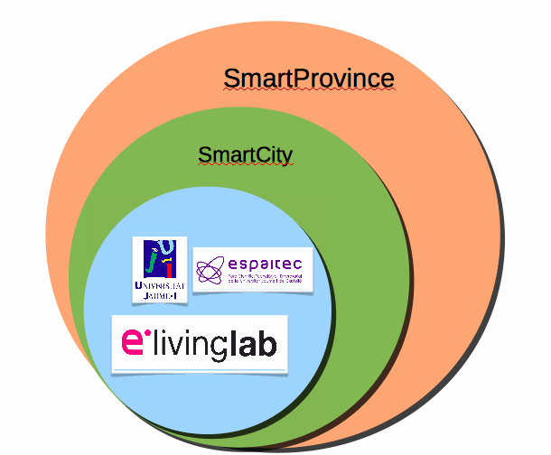
An internationally growing movement
The European Network of Living Labs (ENOLL) has recognized over 320 LLs in Europe
LL are also expanding in Latin America, linked to universities, NGOs, and local governments
The Latin-American research network of Living Labs gathers members from Argentina (15), Brazil (20), Colombia, and Uruguay

Slide 14
4. Co-creation of scientific knowledge: e-Citizen Science
"Citizen Science" is basically the collection of information by general citizenry to deduce theories and determine policy
E-Citizen Science (eCS) or “cyberscience,” is a relatively new term for centuries’ old practice
Most advances are due to new scientific approaches plus the use of ICTs
eCS covers a wide variety of applications: from agriculture to urban planning, astrobiology to software and informatics services, health care to oceanography, social sciences to rocketry

Slide 15
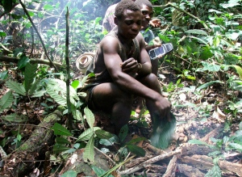
Science prosumers
Customers become “prosumers” by co-creating goods and services rather than simply consuming the end product
In eCS, citizens become science prosumers
This co-creation of knowledge is a considerable leap from an earlier approach in which the scientist is “the expert” and the citizens are basically free research assistants

Slide 16
E-Science in the WSIS
E-science is part of the WSIS Action Line C7, “ICT applications: benefits in all aspects of life”. This line points to E-Science, focusing mainly on improvement of knowledge exchange between scientists, and between scientists and citizens
A rising number of eCS projects are oriented to heighten participants’ acquaintance with science, technology and the scientific process, as well as to modify and enlarge their views to the way science can help them to cope with their needs
eCS projects provide citizens’ training throughout their participation in the scientific process

Slide 17
A process of cultural change may be detected from the late 1990s onwards
The community network social experiences enhance the social appropriation and dissemination of ICT, with the final purpose of community empowerment
Citizens’ assemblies do not view the Internet use as a goal, but as a means for community political organization and for informing citizens about their political, social and economic rights
Living Labs are meant to train citizens to participate in social and technological innovation
E-Citizen Science projects are oriented to the co-production of scientific knowledge, and eventually to technological innovation

Slide 18
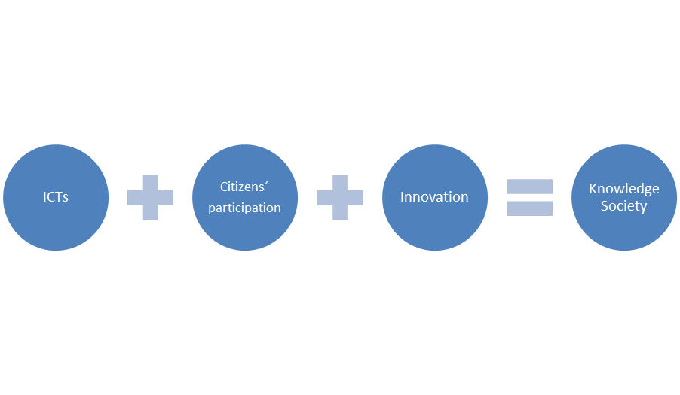
From ICTs appropriation to the production of scientific knowledge

Slide 19
Significant common traits
All these initiatives…
… have innovation (social, political, and/or technological) as their common goal
… include citizens as main actors
…imply a rupture with previous ways of action
… were generated by non-governmental social actors (community organizations, individuals, universities), except in the case of Living Labs

Slide 20
Proposals for WSIS
If innovations are citizen-driven, they will respond more accurately to the communities´ needs
Citizen access, appropriation, dissemination and generation of information and knowledge for development is an issue of institutional and cultural attitude
This implies a necessary cultural change in State institutions, research centers, citizens’ organization, and in the media
It is necessary for WSIS to include the issue of citizen-driven innovation in its agenda

Slide 21

The 2015 horizon
Public policies should be oriented to achieve this change, aiming to impregnate and pervade this new culture in the institutions and organizations
Organizational transformations are needed to encourage citizens to discover a new way to access, manage, create, preserve, and disseminate information
Therefore, it would be beneficial for WSIS to consider innovative non-governmental initiatives in their strategies and policies for 2015

Slide 22
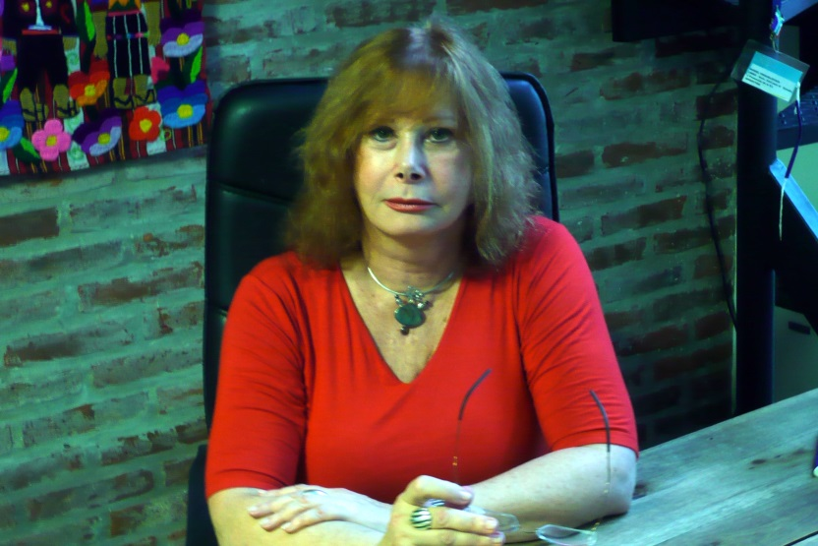
Thank you! Any questions?
Dr. Susana Finquelievich
sfinquel@gmail.com
Skype: susana.finquelievich
@sfinquel

