Slide 1
Building Culture of Open Government in Certain Social Groups of the Khanty-
Mansiysk Autonomous Okrug – Ugra
Alexander ZYKOV
2016
Notes:
Information and Communication Technologies

Slide 2
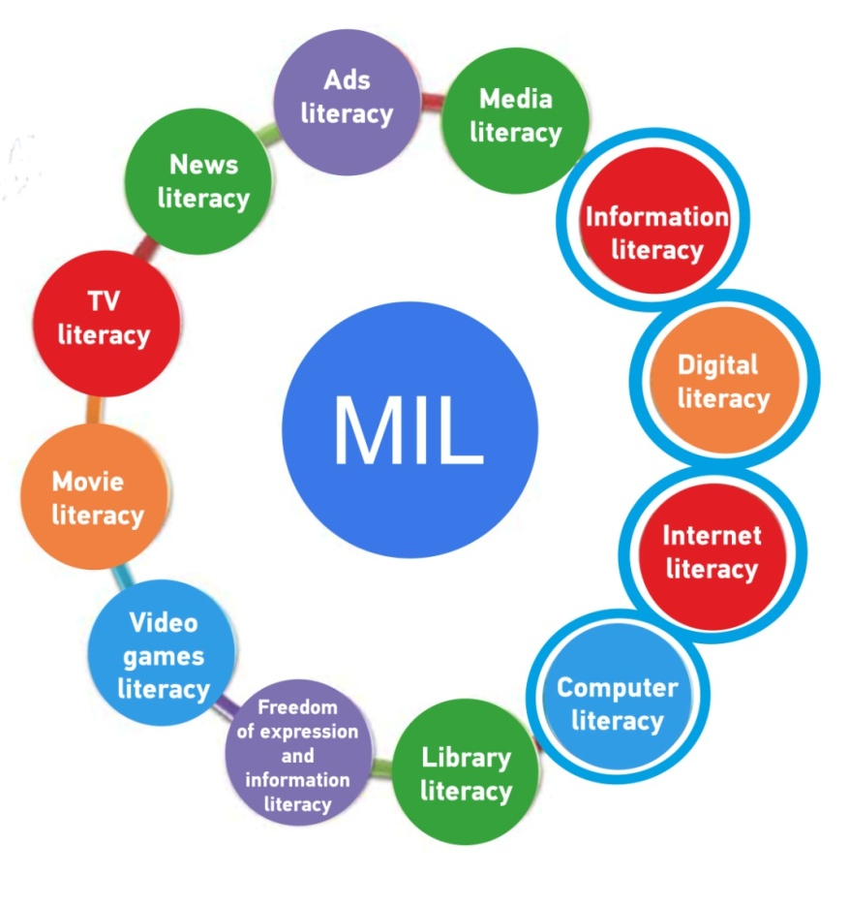
Information technology components of media information literacy (MIL)
ICT
LITERACY
Information and Communication Technologies (ICT)
Digital literacy,
Computer literacy,
Information literacy,
Internet literacy

Slide 3

Information and Communication Technologies literacy factors
TERMINOLOGY AWARENESS
INTERNET OPERATION CONCEPT AWARENESS
BASIC COMPUTER OPPORTUNITIES UNDERSTANDING
USING ICT FOR SOLVING PROBLEMS
INFORMATION HANDLING SKILLS

Slide 4


Complex approach in Information and Communication Technologies literacy training
e-Citizen program
ECDL
File handling
Communication options
Electronic government services (e-Services)
Central and local public authorities sites
Networking
eGov
(E-government) course
e-Government concept
Central and local public authorities sites
E-democracy
Electronic government services (e-Services)
“One stop” principle
Electronic signature
Useful online services (eg.: Housing and public utilities)
Skills complex which provides a citizen an opportunity to become a full member of information society

Slide 5
Information and Communication Technologies literacy training process organization forms
FULL-TIME EDUCATION
DIGITAL EDUCATIONAL CONTENT
ONLINE TESTING
WEBINAR
GUIDANCE MATERIALS
COURSE ELECTRONIC REGISTER
ONLINE STUDY MODE

Slide 6
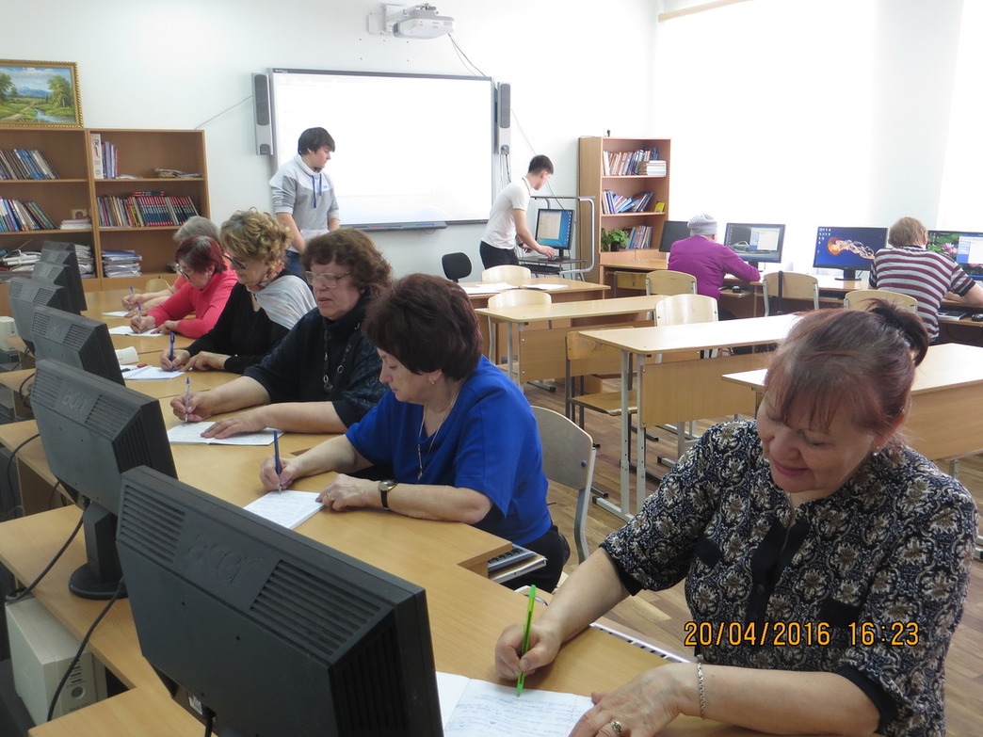
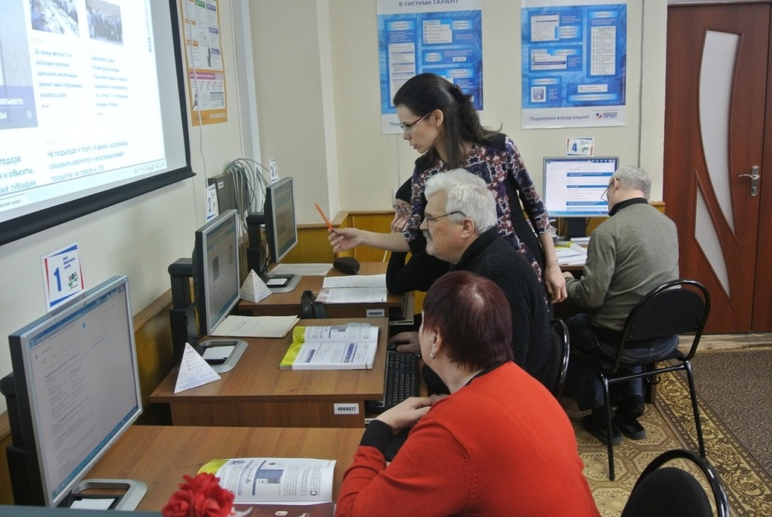
Today Ugra gets second place among Russian regions with Common Government Services Portal registered user (550 thousand people, 43,5% of the total population of the region).

Slide 7
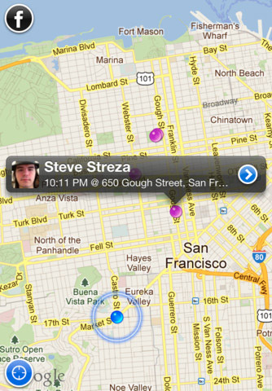

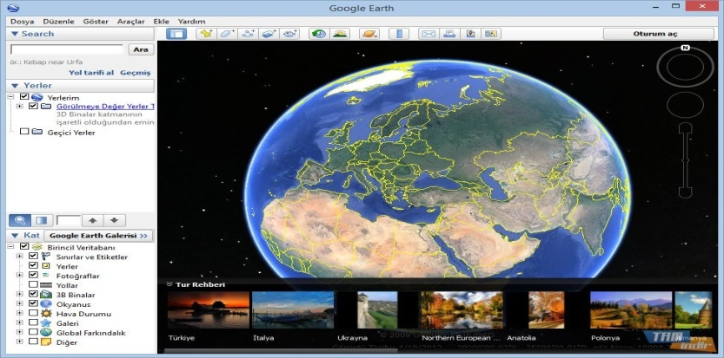


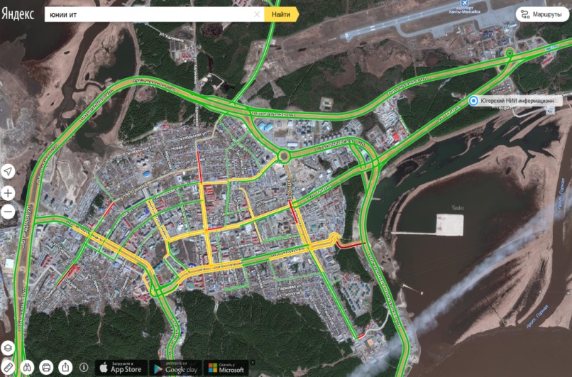
Geoinformation using in everyday life
Google Earth
Information and reference tools, social networks in geospatial map
Traffic jam on maps.yandex.ru

Slide 8

About geoinformation literacy
New idea of “geoinformation literacy” goes from appearance of large information and reference tools amount, which is based on wittings about object mutual arrangement on map
Geoinformation literacy

Slide 9
Geoinformation literacy training
SPECIAL TERMINOLOGY AWARENESS
GEOSPATIAL DATA UNDERSTANDING SKILL
GEOSPATIAL DATA USING SKILL
GEOSPATIAL DATA CREATION SKILL

Slide 10
Geoinformation literacy training stages
PROFESSIONAL STANDARDS DEVELOPMENT
TRAINING AND TALENT MANAGEMENT
SPECIAL COURSES FOR STUDENTS
GEOSPATIAL DATA BASIC OPERATION TRAINING
FOR SCHOOL STUDENTS
Regional and Federal organizations
Regional and Federal organizations based on the Space Services Center
Regional Space Services Center
Interscholastic Space Services Center

Slide 11

Professional Standards Development
PROFESSIONAL
STANDARDS
DEVELOPMENT
Description of typical working processes in professional sphere
Detection of executing tasks set for certain qualified level
Detection of work in progress difficulty level
Detection of knowledge skills essential for professional activities

Slide 12


Professionals and students training
TRAINING AND TALENT MANAGEMENT
Information thematic analysis training
Distributed information resource gaining access training
Special software training
BACHELORS AND MAGISTERS TRAINING
Basic information dimensional analysis training
Geospatial data presentation forms training
Basic geospatial data creation training
Special terminology training

Slide 13

School students training
Geospatial data opportunities using let:
In geography – create maps of different objects, areas, zones etc.
In history – reconstruct maps of warfare and territorial changes.
In regional studies – create maps of ethnic groups, cultures, regional traditions.
In biology – create maps of the Earth biosphere.
In ecology – create maps of the Earth ecosphere.

Slide 14
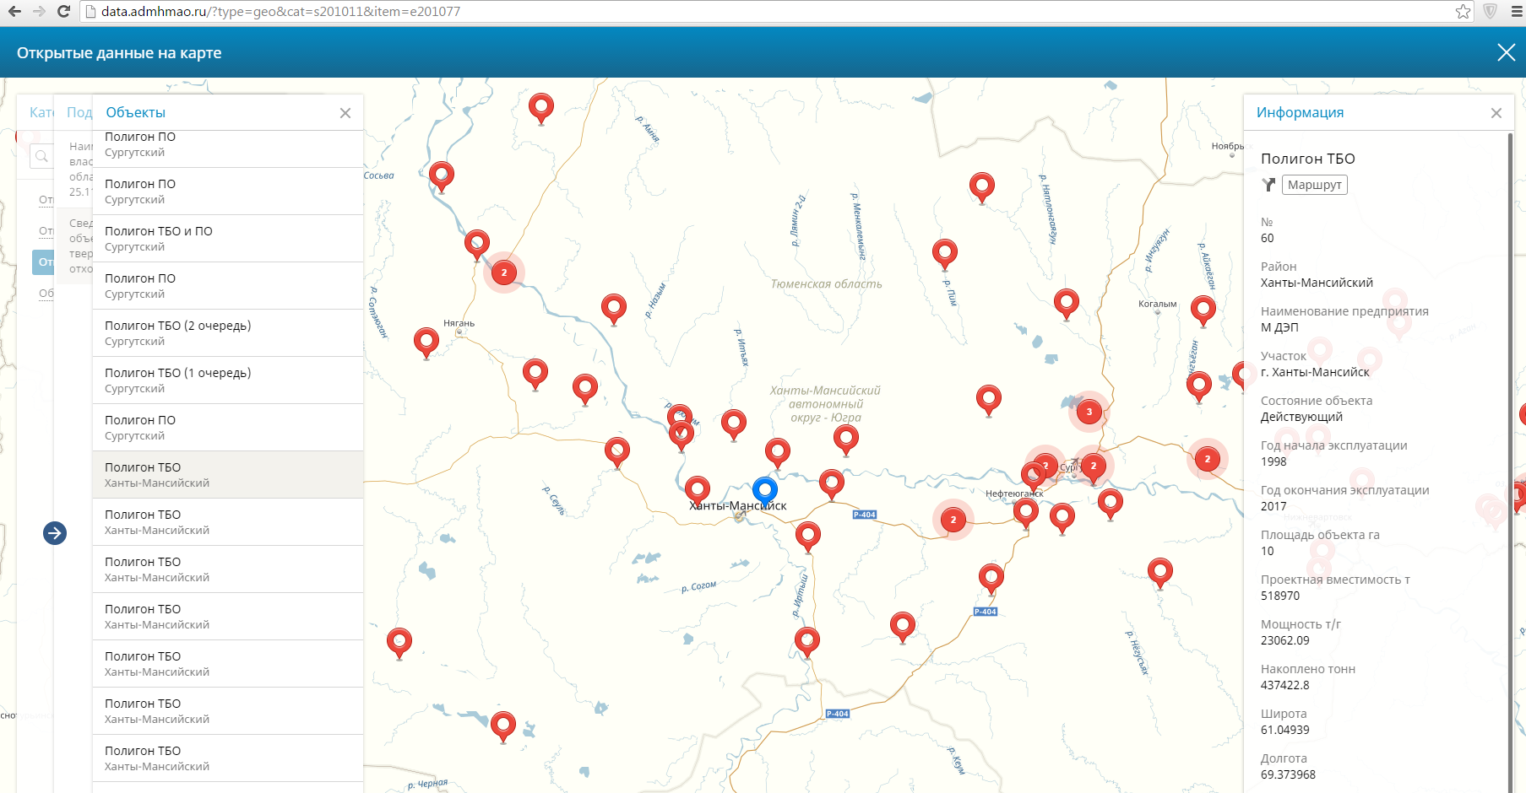
Open Data Portal of the Khanty-
Mansiysk Autonomous Okrug – Ugra

Slide 15
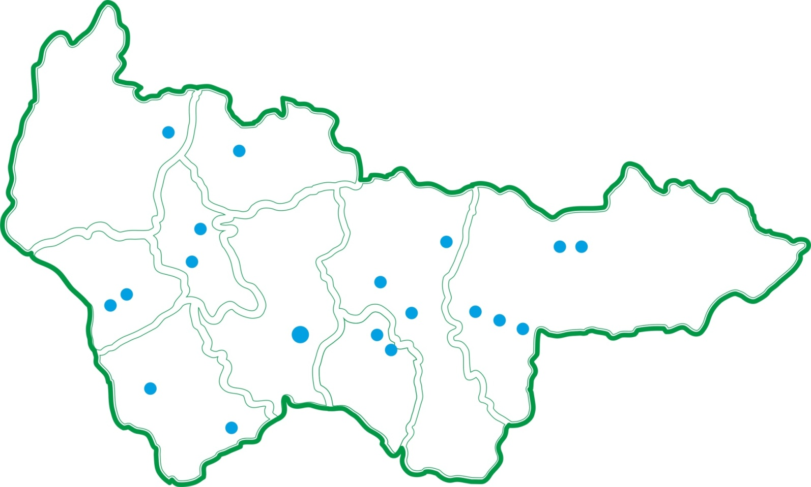
Information and Communication Technologies literacy training geography
Since 2010 more than 40 thousand people has been trained.
More than 15 thousand of them were residents from remote areas
Berezovsky
Beloyarsky
Oktyabrskiy
Kogalym
Raduzhniy
Nyagan
Surgut
Ugorsk
Sovietskiy
Langepas
Khanty-Mansiysk
Nefteyugansk
Megion
Nizhnevartovsk
Urai
Pyt-Yakh
Kondinskiy

Slide 16
Thank you
for your attention!
Faithfully, Alexander ZYKOV +7-982-412-00-11
ZykovAS@uriit.ru

