Slide 1
Media Literacy and Innovation:
From Open Governance to Happiness
Dr. Galit Wellner
The NB School of Design, Israel
Khanty Mansysk, June 2016

Slide 2
What Is Innovation
The Merriam Webster dictionary: “a new idea, device, or method”.
The Business Dictionary: “The process of translating an idea or invention into a good or service that creates value or for which customers will pay”.
A suggested definition: the translation of an idea into an object or a process, under the condition that the idea, the translated object or the translated process is new.

Slide 3
From Innovation
to Media & Information Literacies
From Media & Information Literacies
to Open Governance
Form Theory
How forms impair happiness?

Slide 4
Self Determination Theory (SDT)
Autonomy
Competence
relatedeness

Slide 5
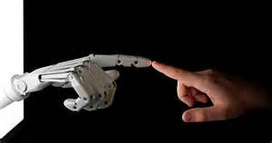

Media & Information Literacies as Open Governance

Slide 6
Thank You!
Dr. Galit Wellner

