Slide 1
Civilizations, technology and literacies
Tapio Varis, professor emeritus
GB of Unesco/IITE
Khanty-Mansiysk, June 66-10, 2016

Slide 2
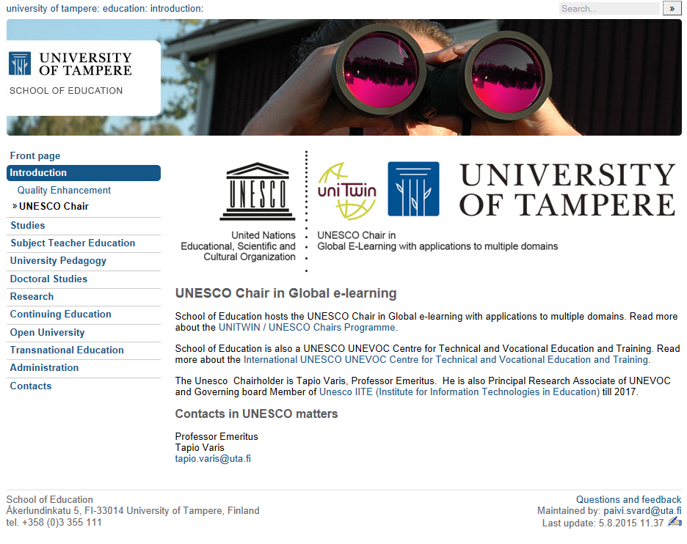

Slide 3
CIVILIZATIONS, TECHNOLOGY AND LITERACIES
Can we speak of global civilization? What is the role of the media in global education and in cultural diversities? The question of the world order and the trend towards global civilization has inspired scholars, communicators, educators and spiritual leaders to answer questions on how the world works
UNESCO: New Humanism, Media and Information Literacy (MIL)

Slide 4
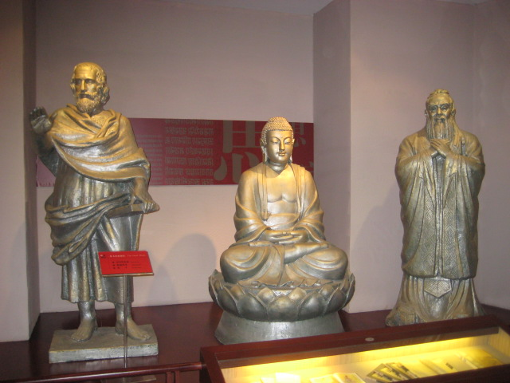
Towards Global Civilization: The Great Minds: Aristotle, Sakyamuni, and Confucius. China Block Printing Museum at Yangzhou, Yangzhou Museum

Slide 5
VISION, RATIONALE AND PRINCIPLES (Unesco: Education 2030)
The renewed attention to the purpose and relevance of education for human development and economic, social and environmental sustainability is a defining feature of the Education 2030 agenda. This is embedded in its holistic and humanistic vision, which contributes to a new model of development. That vision goes beyond a utilitarian approach to education and integrates the multiple dimensions of human existence . It understands education as inclusive and as crucial in promoting democracy and human rights and enhancing global citizenship, tolerance and civic engagement as well as sustainable development. Education facilitates intercultural dialogue and fosters respect for cultural, religious and linguistic diversity, which are vital for achieving social cohesion and justice.

Slide 6
Towards 2030: a new vision for education
SDG 4 “Ensure inclusive and equitable quality education and promote lifelong learning opportunities for all”
expanding access to education
Inclusion and equity in and through education
gender equality
quality education and improving learning outcomes
quality lifelong learning opportunities for all
conflict-affected areas: crises, violence and attacks on education institutions

Slide 7
New humanistic awareness
NEW HUMANISM
Human being over technology
Critical to technology
Autonomy over global communication
Diversity
Universal rights and responsibilities
OLD HUMANISM
Human being over theology
Critical to classic texts
Discovery of self
New world
Cosmopolitanism

Slide 8
Posthumanism
Antihumanism (critical of traditional humanism)
Cultural posthumanism (critical of the foundational assumptions of Renaissance humanism and its legacy)
Posthuman discourse: loss of subjectivity based on bodily boundaries
Transhumanism (technologies that eliminate aging, enhance human intellectual, physical, and psychological capacities (”posthuman future”)
AI takeover (humans replaced by artificial intelligence)
Voluntary human extinction (”future without humans”)

