Slide 1


Access to information and knowledge for open government:
The contribution of libraries and IFLA
Dr. Maria-Carme Torras i Calvo
Library director, University of Bergen
Governing Board member, IFLA
Notes:
Aim: to present how libraries at a national and global level are contributing to open government by providing and advocating for access to info and knowledge.
to discuss open access to info and knowledge as a prerequiste for open government, access including MIL
To address some of the barriers to sustainable long-term access to info
To explain how libraries are supporting access to info for OG, national and global.

Slide 2
Outline
Access to information and knowledge
MIL and access
Barriers to access
Library contribution to sustainable long-term access to information:
  Academic libraries, IFLA

Slide 3
Open government
Transparency of actions
Accountability for policy and service delivery performance
Accessibiblity of services and information
Responsiveness of government to new ideas and needs
Public engagement
Sources: OECD, 2005; Open Government Declaration, 2011
Notes:
Will not attempt to provide a comprehensive definition here, but having had a look at several definitions. What characterises open government?
Access to information is a building block oopen governments

Slide 4

Access to information and knowledge is a condition for open government.
Access can be improved by opening up data and content.

Slide 5
Open government content
can be freely used, reused and redistributed by anyone
produced or commissioned by government
key to social, educational and economic growth and greater digital inclusion
  transparency through access, sharing and reuse
  participatory governance, citizens informed and eganged in decision making
Source: http://opengovernmentdata.org

Slide 6
Media and information literacy and access
Analogue/digital access
+
Intellectual access
MIL also a condition for open government
Notes:
BUT physical/digital access is not enough!
MIL as defined by UNESCO
Analogue/digital access to data and content is not enough to build up a culture of open government.
At the heart of MIL lie critical thinking, inquiry and analysis as key competencies
Intellectual access: Ensuring that people have the competencies to find, understand, use, create, share contents critically and ethically, in whatever form or format.
Two sides of the same coin: physical/digital access to contents no use without MIL; MIL no use without the possibility to access contents

Slide 7

MIL
Critical thinking, inquiry, analysis when engaging in personal, societal or professional activities
Prerequisite for fostering equitable access to information and knowledge
Photo: UBB

Slide 8
MIL at the workplace
Study of needs for published scholarship at the Norwegian workplace:
Health sector
Regional government, municipality
Research institutes
Library provision: Digital access + guidance/training
Source: På tvers - regional tilgang til forskningsressurser. Prosjektrapport, fase 1: Kartlegging (https://bora.hib.no/nb/item/624 )
Notes:
Confirmed by a study

Slide 9
Barriers to access
Rising costs of access to digital scholarly resources, growing global austerity, budget cuts
Restrictive license terms limit use of acquired resources
Restricted open access in licenses, e.g. embargos
Inadequate legislative frameworks, e.g. no sharing across borders
Notes:
The rising costs of access to digital scholarly resources, such as journals and databases, are placing great pressure on library budgets in a time of growing global austerity. Restrictive license terms limit what can be done with resources that can be acquired. Where alternative delivery mechanisms exist, such as through Open Access, they are being co-opted by large academic publishers who undermine the benefits of these new systems through embargos and double-dipping. In the commercial sector, large technology and media companies direct the eBook market in such a way that prevents libraries from buying eBooks, and users from owning titles they have paid for.
Legislative frameworks which in many states used to support libraries’ public interest functions as providers and preservers of information for all members of society are less and less effective. For example, out of date provisions governing copyright cannot facilitate preservation activities in the digital age, nor can they take advantage of the Internet’s global nature by sharing information across borders. Where new legislation is being crafted library users are often negatively impacted, as laws designed to prevent terrorism increase surveillance of information seeking and undermine individuals’ freedom of expression online, while open government remains more a goal than a reality. Many countries of course still lack basic library laws.

Slide 10
Unsustainable access to published scholarship
Cutting down on actual access for researchers and students
Not sufficient access for the general public
Not sufficient access for professionals outside universities, who are required to work evidence-based, e.g. health services
Notes:
Less access despite more info available and thar researchers do a lot of the publishing work.
Access is cut out the minute one leaves university.
Academic libraries cannot open for access. They cannot afford licenses.

Slide 11
Immediate transition to open models of access to published scholarship
What are libraries doing at national and global level?

Slide 12
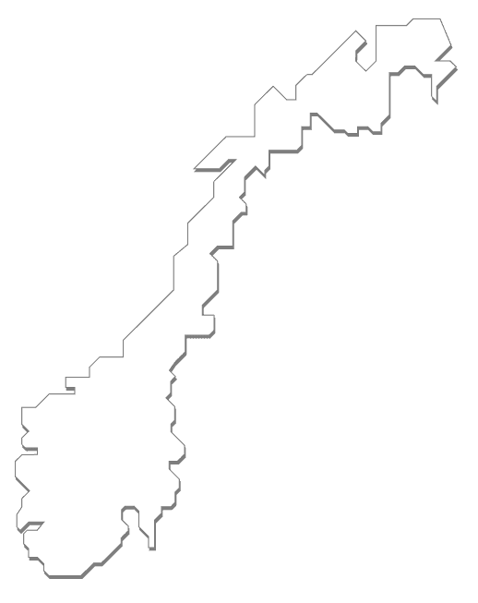
Sustainable access to information
Results from research publicly funded must be available to the public
(2 white papers*, Horizon 2020)
Availability crucial to build up open government
*St.meld. nr. 30 (2008-2009) Klima for forskning; St.meld. nr. 18 (2012-2013) Lange linjer – kunnskap gir muligheter.
Notes:
In Norway – OA requirements

Slide 13

The contribution of academic libraries
  Partners in creating university policies for open science (OA publications, open research data)
  Providing infrastructure for OA
    Institutional repositories
    University OA publishing fonds
    OA journal and book publishing support
    Digital curation of research data
Notes:
Academic library contribution
BOAP – libraries open access journals. 40 in Norway – Stockhom Univ Library

Slide 14
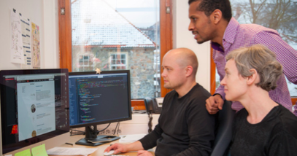
  OA guidance (MIL for researchers):
  copyright, research visibiblity, publishing channels, research data management
Photo: UBB
Notes:
Academic library contribution

Slide 15
Engaging in national and international processes to move away from subscription-based models to open access models:
  Negotiating OA content with publishers for our library consortia licenses
  National guidelines for OA publishing
  Follow-up of the Berlin 12 conference
Notes:
being part of the conversation, teaming up with other important national stakeholders

Slide 16

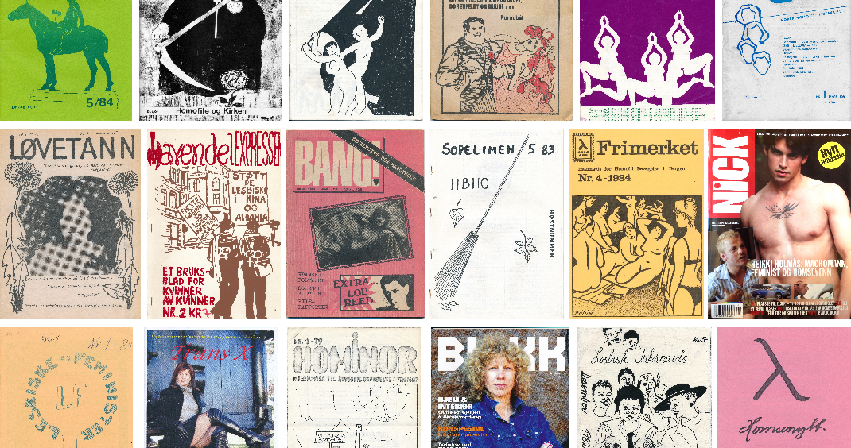
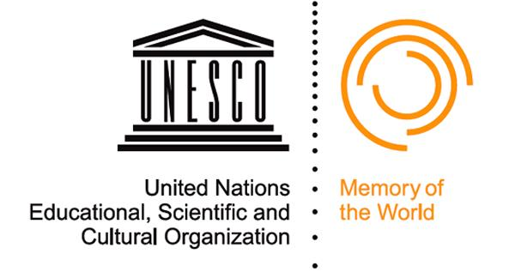
Making unique content globally available
The Norwegian LGBT Archives
- commissioned to UiB Libraries
- state budget
- collect, document,
digitise and communicate
Notes:
Skeivt arkiv is the Norwegian national archive for queer and LGBT history. Our key mission is to collect, document and communicate Norwegian and Scandinavian queer history. Our collections consist of a series of personal and organisational archives as well as books and journals. Materials from our collections are made available through this website. We are also in the process of creating our online encyclopedia Skeivopeda, or "Queeropedia", which is continously updated with new articles about people, themes, events and organisations.

Slide 17
Speeding up the transition to OA?
Competitiveness Council, May 2016
European ministers united on ambitious goals to making immediate access to scientific publications the default for 2020.
Europe’s 28 member states have agreed to common ambitious political Open Science goals for the first time.
Realistic? Operationalisation?
In any case a good push!
Source: http://data.consilium.europa.eu/doc/document/ST-9526-2016-INIT/en/pdf
Notes:
The Competitiveness Council, a gathering of ministers of science, innovation, trade and industry, met to discuss Open Science amongst other issues on 26-27 May 2016. This meeting saw a set of Council conclusions towards a transition towards an Open Science system adopted by all of Europe’s 28 member states. This means that together, Europe’s governments have agreed to common ambitious political Open Science goals for the first time.

Slide 18
The contribution of IFLA
UN 2030 Agenda
2 years of advocacy at the UN: the role that access to information plays in supporting sustainable development
  Universal literacy in the Agenda’s vision
  SDGs, target 16.10: “Ensure public access to information (…)”
Enabling libraries to engage in National Development Plans to implement SDGs
Notes:
National level not enough – need to work globally
leading international body representing the interests of library and information services and their users.
We now have 1500 Members in approximately 150 countries around the world.
A lot of IFLA activity contributes to fostering open governments, but would like to highlight a couple of priority areas.
UN work IFLA part of a civil society coalition
The new 2030 Agenda is a framework of 17 Sustainable Development Goals (SDGs) with a total of 179 Targets spanning economic, environmental and social development. They lay out a plan for all countries to actively engage in making our world better for its people and the planet.
IFLA welcomes the 2030 Agenda and is pleased to see access to information, universal literacy, safeguarding of cultural and natural heritage, as well as access to Information and Communication Technologies (ICT) strongly represented across it. We are particularly pleased to the see the strong mention of access to information in Target16.10:
“Ensure public access to information and protect fundamental freedoms, in accordance with national legislation and international agreements”
Universal literacy in the vision.

Slide 19
Copyright exceptions and limitations for libraries and archives
Working closely with WIPO since 2014.
Treaty to guarantee access to information as well as acknowledging all parts´ legitimate interests.
Notes:
Advocating for copyright exceptions and limitations for libraries and archives.

Slide 20

Libraries and open government
Access to information and knowledge
Contents no longer limited to collections within library walls, but to information and knowledge in whatever format and form
Not just locating specific contents, but enabling users (MIL education)
Promoting user creation and sharing of contents
Photo: UBB
Notes:
What are libraries doing?
Redefined core mission and activities with the advent of the internet and the ever growing amount of info.

Slide 21

Thank you

