Slide 1
Digital Culture, e-Democracy and
Open Government the re-engineering of human mind by digital culture
Árpád Rab
International Conference Media and Information Literacy for Building Culture of Open Government
Khanty-Mansiysk, Russian Federation 6–10 June 2016

Slide 2
Summary
  Culture as a weapon of mankind
  My main question is: what is the real role of digital culture in human history?
  The nature of digital culture
  Main trends
  Urbanization
  One answer – digital culture and open government
Connection
Digital culture
Open government
Notes:
Kibera is a neighborhood in the emerging megacity of Nairobi, and the largest urban slum in Africa.
Az emberiség fegyvere a kultúra, többször is újraprogramozza magát
Ennek az eszköze/kiváltója/következménye sokszor egy technológiai innováció
Ezt leglátványosabban a kommunikáció és érzékelés mentén teszi – avagy mit érzékel és hogyan működik az ember?
Ha a kultúra válasz, akkor mire válasz az információs társadalom? A válaszok közül egyet tekintünk át előadásunkban

Slide 3
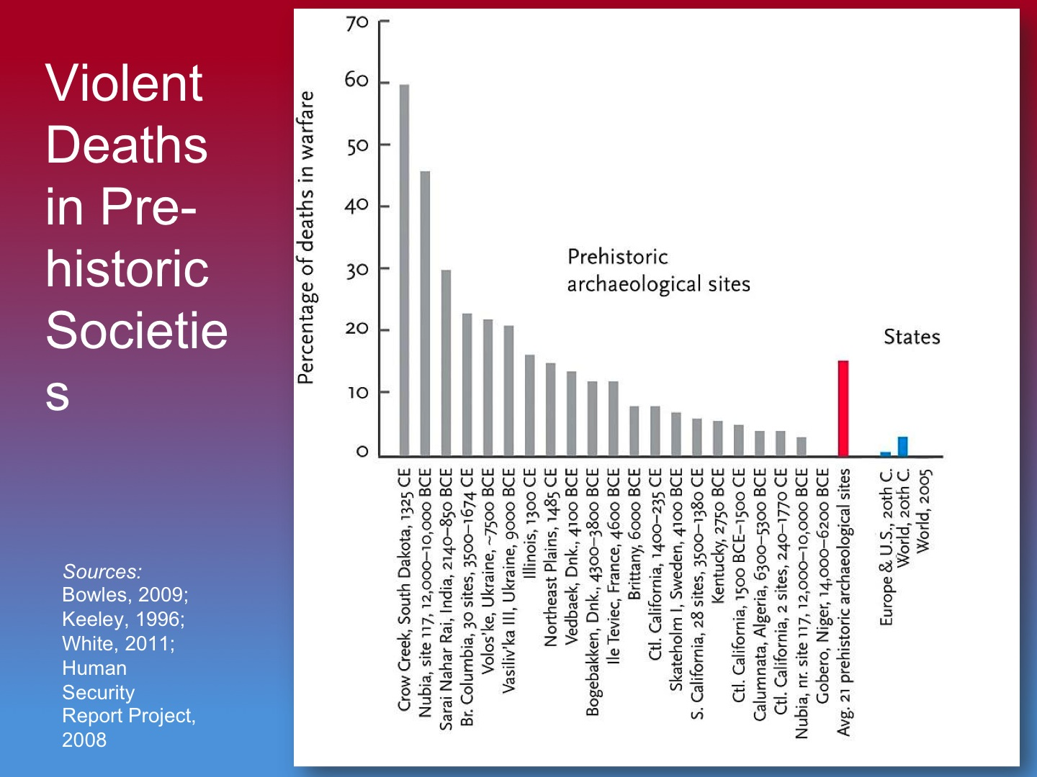
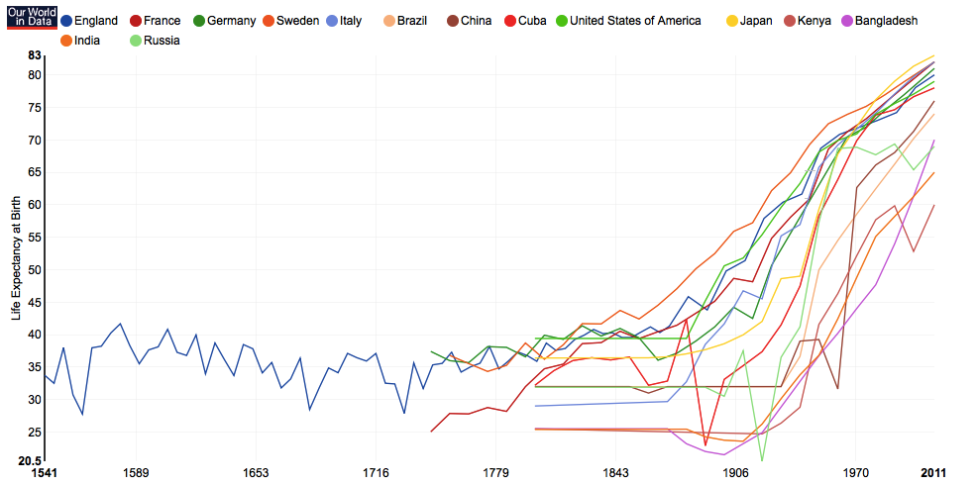
Culture as tool
The culture is the survive strategy of human kind. It is working: for example the decreasing of physical violence in society, or the increasing length of our lives etc. This speedily biological changing of a race is unique in the Earth.
There are a lot of crises: economy, energy, population, pollution, societal, natural resources etc. There were always crises, but now they are global
ICT has the role to solve these challenges
We can see the direction of technological development: personalized knowledge gathering and being always on-line

Slide 4
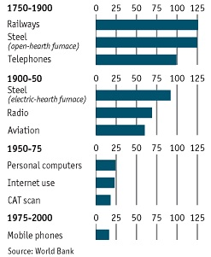
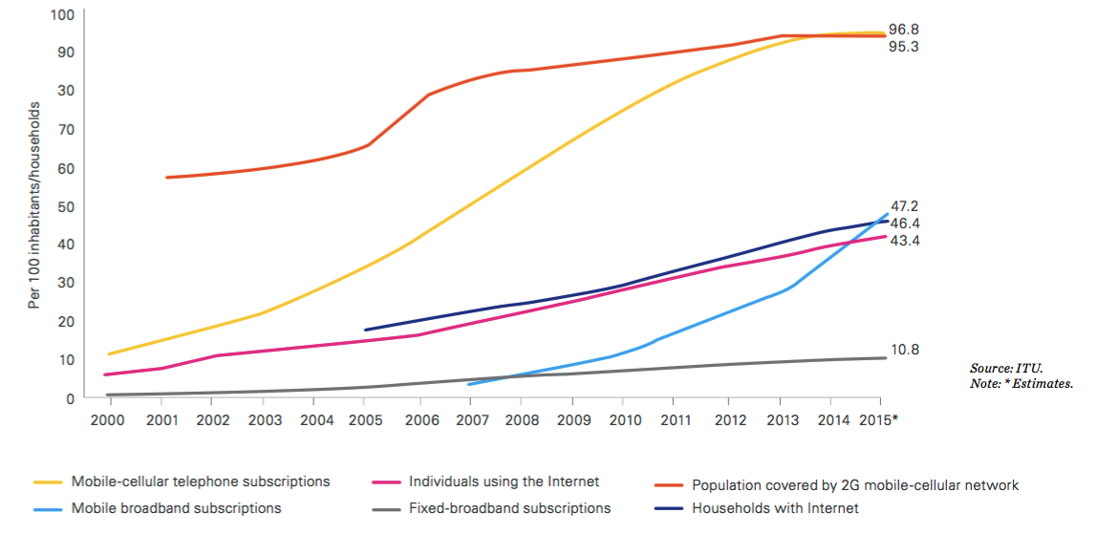
Accelerating changes
Mobile phone: everybody needs it, this is a vital human need – to connect with people who are far away, and to gather information everywhere
Spreading of innovations: the ICT is the first everything-changer innovation what affected every generation in the same time. The natural and accustomed way of knowledge sharing changed.

Slide 5
The characteristics of digital culture
Oral literacy
Splitting from source
Stability
Copyable
Immediacy
Interactivity and interconnectivity
Sense and
experience
Identity
Uncertainty
Speed and
incomprehensibility
Multitasking
The use of micro-time
The twin circle of digital culture – a holistically and complex model of digital culture
Notes:
The use of micro-time is the latest characteristics of digital culture (naturally until nowadays, the next one will be the virtual, or augmented reality). With the operation systems of smart phones we can chat and play without loading, or signing in times. This is very important because with this innovation ended the time and geographical gap between traditional and digital culture: because of instantly using, we use chats, games, mails every time, and when we have only very limited time (3-4 seconds), too.

Slide 6
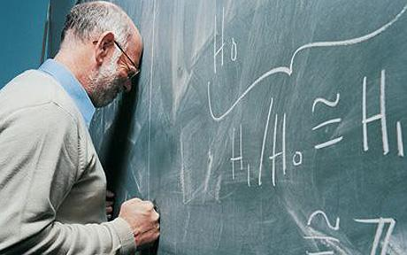
The digital culture
The digital culture is changing the human mind in a biological way, too
Effective
Radical
Two big trends:
Departure from the biological reality
New knowledge gathering systems
Why is this re-engineering?
Notes:
We give up a lot of cultural objects – photos, writings, money, gifts etc. We can’t touch these items
The information what we need when we need – it changes the respect of schools, the information gathering, the memory etc.

Slide 7
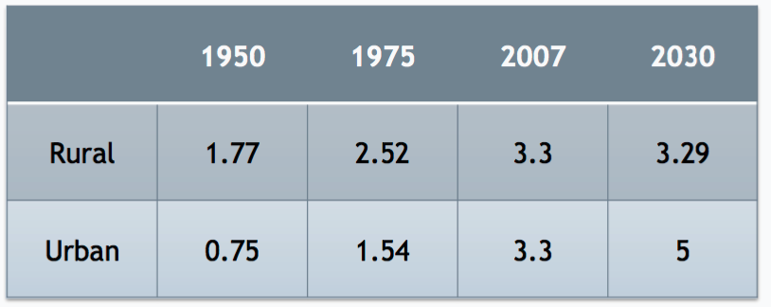
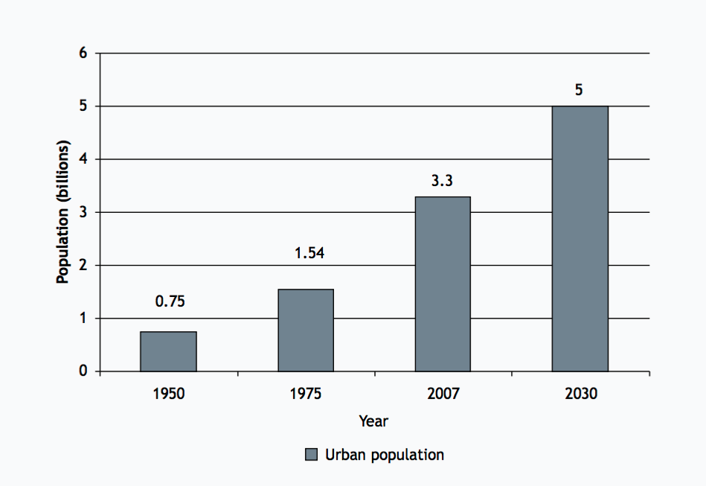
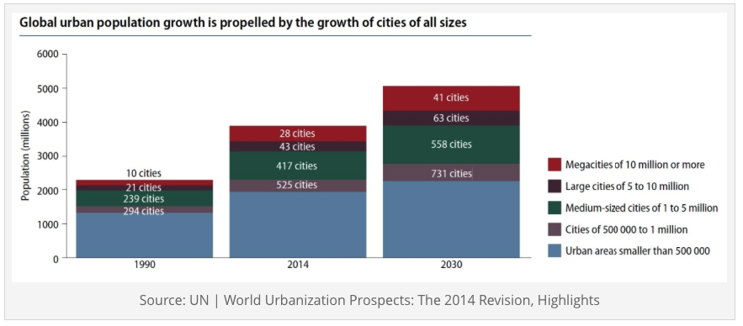
Urbanization
The first time in the life of Human the half population of Earth lives in cities (3,7 billion people, it will be doubled until 2050)
Notes:
http://ocw.jhsph.edu/courses/urbanhealth/PDFs/Urban-sec2_Baqui.pdf

Slide 8


The generations of smart city
First and second generation smart cities
Smart things
Technological defence-systems
Third generation smart cities
Smart people
Social network
Smart support of local services
Coomunity consumer protection
Smart e-health
Community assistance
Use the services of the city
Community time-bank
Notes:
The future of smart city is not the technology, but the connected humans with various resources.

Slide 9
One answer
This cooperation of people can't happen without digital culture. The digital culture made two fundamental changes: the skill to cooperate with strangers (Uber, Airbnb etc.), and automatized data sharing and exchanging.
This is the answer: the digital culture transform us into digital cooperation-machines
This cooperation (beside other advantages) help us to live in cities
There were social cooperation actions in the past, naturally. But such a large scale, (digitally) automated, between strangers has never been existed. We can sleep in stranger's house, traveling by car with strangers, exchange tools, cultural objects and so on.

Slide 10
Projects in Óbuda, Hungary
In our smart city projects in Óbuda (Budapest, Hungary) we connect the people via various projects:
Open spaces - this program makes available unused rooms of public institutions for the community activities
Ragweed collecting - searching and collecting of a harmful vegetable
Jam making - to help the meeting of farmers and jam-makers just-in-time
Public irrigation with water given by self-government, made by population
Community movie project - systematically sharing of projectors in big block-buildings creating film-club and meeting solution
Digital Literacy Education Program
Community kindergarten and pre-school program - to create a flexible solution for parents
To run these projects we need data and legal and moral support of self-government. This data help us to identify the people who are interested in the project.

Slide 11
Digital culture and e-government
The future of open e-government is to connect (with the help of data). The (self)-government in the future is not a building, but a well-built application and a lot of data operators. This is the top-down side.
The main goal of using data is: whom, and how to connect to reach successful cooperation to help the life of community.
The role of government will be to connect the right people in the right place with the right resources.
The conquest of digital culture over our minds is irreversible and very radical. It is a solution, not a problem.
The open government is not about open data – it is about the open connections. We don’t have time to prepare, open, and share all data with everybody. We don’t have time because the new generations are here, and because of in the era of big data creating data is much more quicker than sharing them with public.
Both side are interested:
  The government of industrial era is not important for new generations – this kind of open government will be very important for them.
  The generations of digital culture will have more solutions to create and control their life
The way to help people: to improve MIL and the critical thinking. The bottom-up side of good open government is the well connected, information-awareness people.

Slide 12
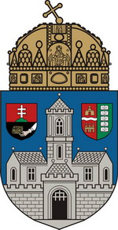
Thank you for attention!
Óbuda University
Digital Culture and Human Technology Center
rab.arpad@dkht.uni-obuda.hu
Skype: rab.arpad
phone, Viber: 36203332302

