Slide 1
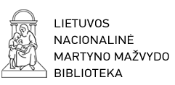
Impact of Information and Communication Technologies (ICT) on Society
2013.09.10
Yuzhno-Sakhalinsk
Prof. Dr. Renaldas Gudauskas
Director-General
Martynas Mazvydas National Library of Lithuania

Slide 2
The Key Message
..the new knowledge-networked economy requires a totally different strategic management mindset and toolbox.
The traditional approaches are not completely obsolete, but used on their own they are inappropriate for sustainable organizational performance and survival in today’s knowledge-networked economy.

Slide 3
Globalization
National governments must set the appropriate ICT strategies, which underpins SOCIAL, cultural AND economic prosperity.

Slide 4
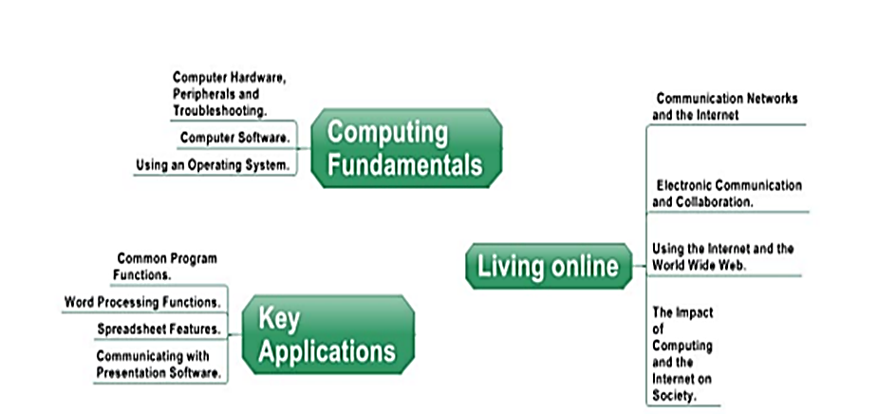
Computing, applications, living
Source: JRC Technical Report , 2011

Slide 5
The challenge today: Changing the Rules of the Game
THE KEY CHALLENGE FOR EACH ORGANISATION IS TO BECOME THE ARCHITECT OF REVOLIUTION IN ITS INDUSTRY, LEAVING OTHERS TO PLAY CATCH-UP. THE COMPETITIVE ADVANTAGE FOR ORGANISATIONS INTENT ON WINNING IN THE NEW ECONOMY IS NON-LINEAR INNOVATION.

Slide 6
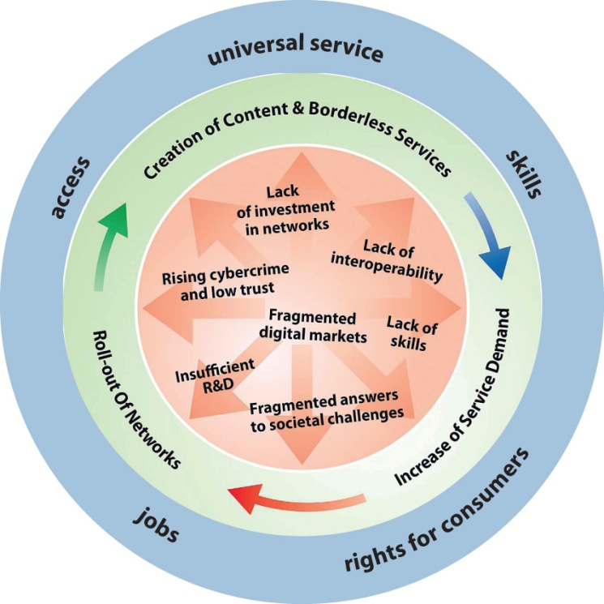
Virtuous cycle of the digital economy
Source: ECA Digital Agenda for Europe , 2010

Slide 7
FIVE KEY TRENDS WHICH WILL CHANGE OUR INFORMATION ENVIRONMENT
TREND 1: NEW TECHNOLOGIES WILL BOTH EXPAND AND LIMIT WHO HAS ACCESS TO INFORMATION;
TREND 2: ONLINE EDUCATION WILL DEMOCRATISE AND DISRUPT GLOBAL LEARNING
TREND 3: THE BOUNDARIES OF PRIVACY
AND DATA PROTECTION WILL BE REDEFINED
TREND 4: HYPER-CONNECTED SOCIETIES
WILL LISTEN TO AND EMPOWER NEW VOICES AND GROUPS
TREND 5: THE GLOBAL INFORMATION
ECONOMY WILL BE TRANSFORMED BY NEW TECHNOLOGIES
Source: IFLA Trend report, 2013 Singapure

Slide 8
The Challenge
One of the main new challenges today is to ensure persistent and consistent growth of knowledge economy serving the basis for human development.
Our concept consists of the two main components of development:
information society development;
knowledge economy development.

Slide 9
Information Policy
The information policy is determined as the set of rules, regulation and standarts that controls the access to information for society.
National information policy is a key issue of culture, knowledge and information institutions.

Slide 10
What is the Knowledge Economy?
It’s about:
Improving productivity, competitiveness, and growth;
New approaches to education, innovation, and the use of ICT;
Networking, inclusiveness, partnership
A different role for Government

Slide 11
What does a Knowledge-based Economy Look like?
Education systems that ensures that citizens are equipped to acquire, use, and share knowledge
Innovation systems that bring together researchers and businesses in commercial applications of science and technology
An information society infrastructure that gives all people access to affordable and effective information and communications
An economic and institutional framework that ensures a stable macroeconomic environment, competition, flexible labor markets, adequate social protection

Slide 12
The Innovation System
Macroeconomic and regulatory context
Education and training system
Communication Infrastructures
Global Innovation Networks
Knowledge generation, diffusion & use
Firms capabilities & networks
Regional Innovation systems
Clusters of industries
Other research bodies
Science system
Supporting institutions
Product market conditions
National innovation system
Factor market conditions
National innovation capacity
COUNTRY PERFORMANCE
Growth, job creation, competitiveness
Source: OECD, 2007

Slide 13
Strategic Knowledge Management
70%
PEOPLE
TECHNOLOGY
Attitudes, Sharing, Innovation, Skills, Team work, Motivation, Organization, Vision/Objectives, Communities Standards
Data stores & formats, Networks, Internet, Data Mining & Analysis, Decision tools, Automation Standards
LEARNING
10%
PROCESS
KM Maps, Work flows, Integration, Best Practices, Business Intelligence Standards
n% = effort required
20%
Source: Bhatt KM strategist, 2003

Slide 14
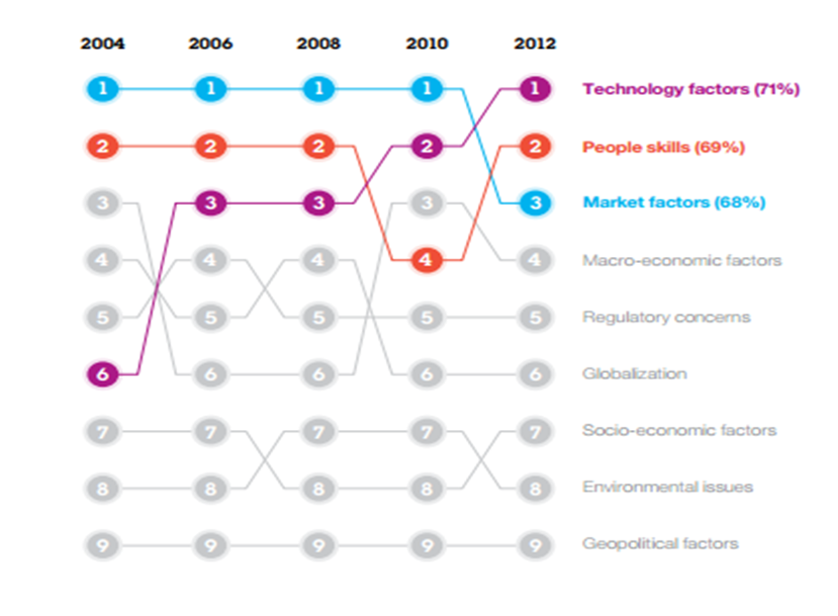
Leading Through Connections: CEOs now see technology change as most critical
Source, IBM Leading Through Connections , 2012

Slide 15
ICT Literacy
Source: EC, JRI for Prospective Technological studies, 2010

Slide 16
DIGITAL LITERACY
Source:Futurelab,2010

Slide 17
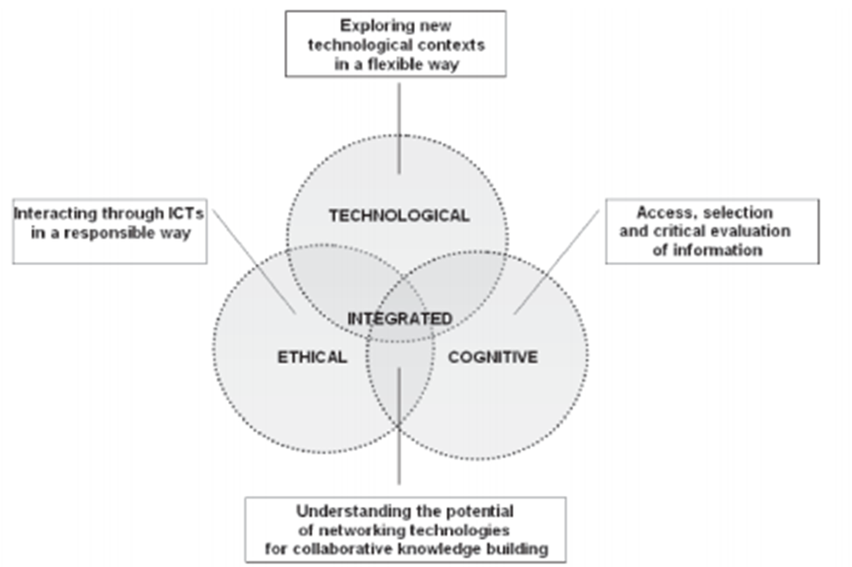
Digital Competence Assessment
Source: Calvani et al., 2009

Slide 18
SKILLS GAP
Source: „Strengthening e-Skills for Innovation in Europe“, 2010

Slide 19
SKILLS PYRAMID
Source: „Who Cares“Who Dares? Providing the skills for an innovative and suitainable Europe“, 2009

Slide 20
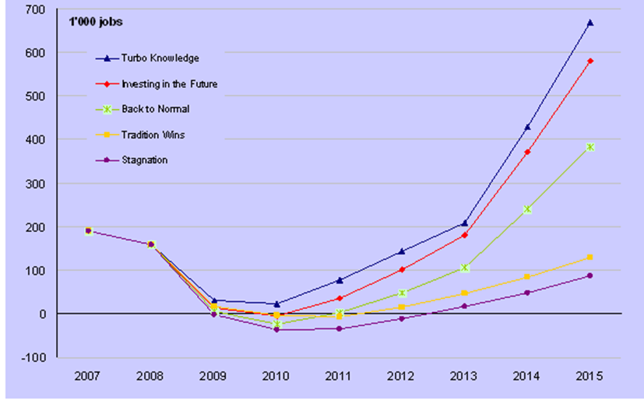
e-skills Demand and Supply Gaps (excess demand) in the EU27 until 2015
Source: empirica and IDC, e-Skills Monitor , 2009

Slide 21
SCENARIOS OF TURBO KNOWLEDGE ECONOMY
Turbo knowledge economy – Take off in Europe, thanks to a virtuous circle of productivity and economy growth driven by widespread diffusion of ICT-based innovation.
Investing in the future – Return to moderate growth, accompanied by acceleration of ICT investments and innovation.
Back to normal – A return to the gistorical developmen trajectory experience before the crisis, in terms of growth rates and IT innovation.
Tradition wins – After the crisis, export – driven recovery favours traditional industrines, rather than high-tech and innovative industrines, resulting in moderate economic growth with low ICT growth. Relocation of the ICT industry outside Europe accelerates.
Stagnation – Very slow recovery, accompanied by domestic protectionism in most important countries, discouraging innovation investment. The European socio-economic systemstruggles to keep up with emerging economies and tends to close itself off. Low ICT investments and growth in It off-shorting lead reduction in demand for e-skills and potentially over-supply.
Source: empirica and IDC, e-Skills Monitor , 2009

Slide 22
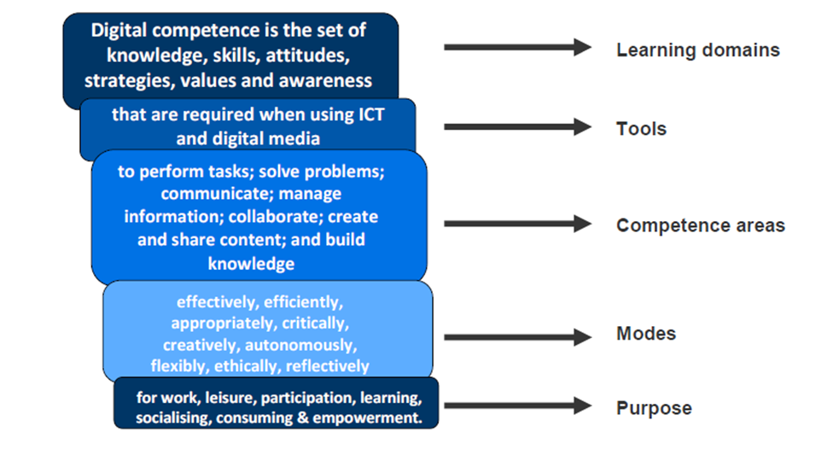
DigitaL COMPETENCE
Source: Ferrari, 2012

Slide 23
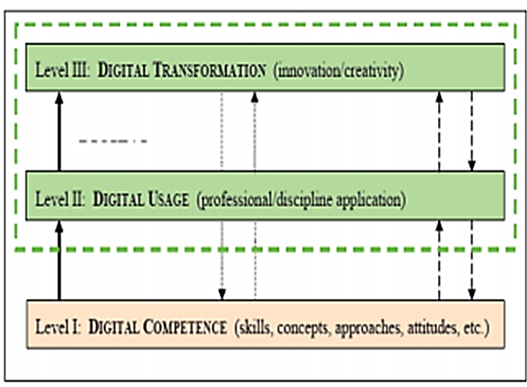
DigEuLit THREE LEVELS
Source: JRC Technical Report , 2011

Slide 24
Technological Risk Descriptions
Critical systems failure | Single-point system vulnerabilities trigger cascading failure or critical information infrastructure and network.
Cyber attacks | State-sponsored, state affiliated, criminal or terrorist cyber attacks.
Failure of intellectual property regime | Ineffective intellectual property protections undermine research and development, innovation and investment.
Massive Digital misinformation | Deliberately provocative, misleading or incomplete information disseminates rapidly and extensively with dangerous consequences.
Massive incidents of data fraud/theft | Criminal or wrongful exploitation of private data on an unprecedented scale.
Mineral resource supply vulnerability | Growing dependence of industries on minerals that are not widely sourced with long extraction-to-market time lag for new sources.
Proliferation of orbital debris | Rapidly accumulating debris in high-traffic geocentric orbits jeopardizes critical satelite infrastructure.
Unintended consequences of nanotechnology | The manipulation of matter on an atomic and molecular level raises concerns on nanomaterials toxicity.
Unintended consequences of new life science technologies | Advances in genetics and synthetic biology produce unintended consequences, mishaps or are uses as weapons.
Source: World Economic Forum, 2012

Slide 25
Technological Risks
Source: World Economic Forum, 2012

Slide 26
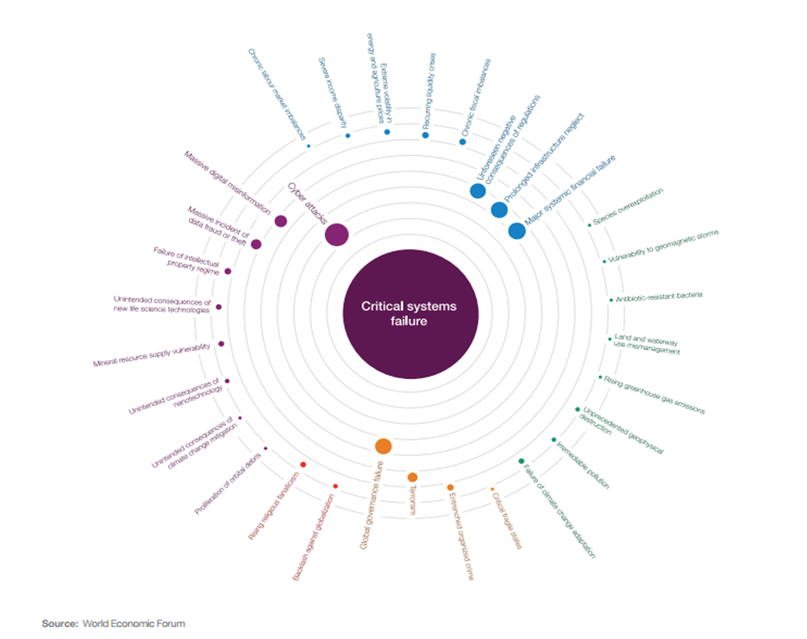
Critical systems failure
Source: World Economic Forum, 2012

Slide 27
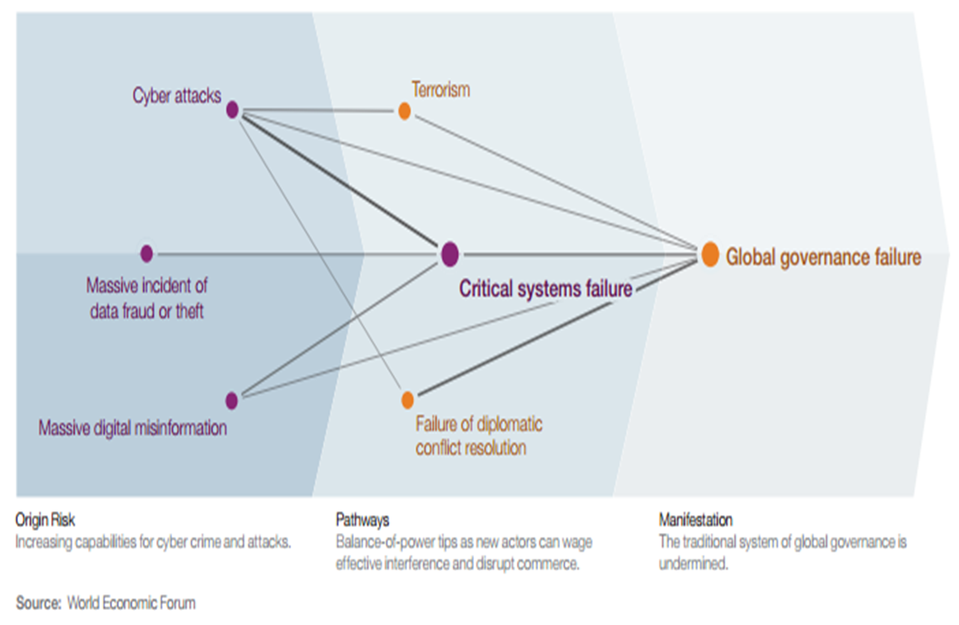
The Dark Side of Connectivity Constellation
Source: World Economic Forum, 2012

Slide 28
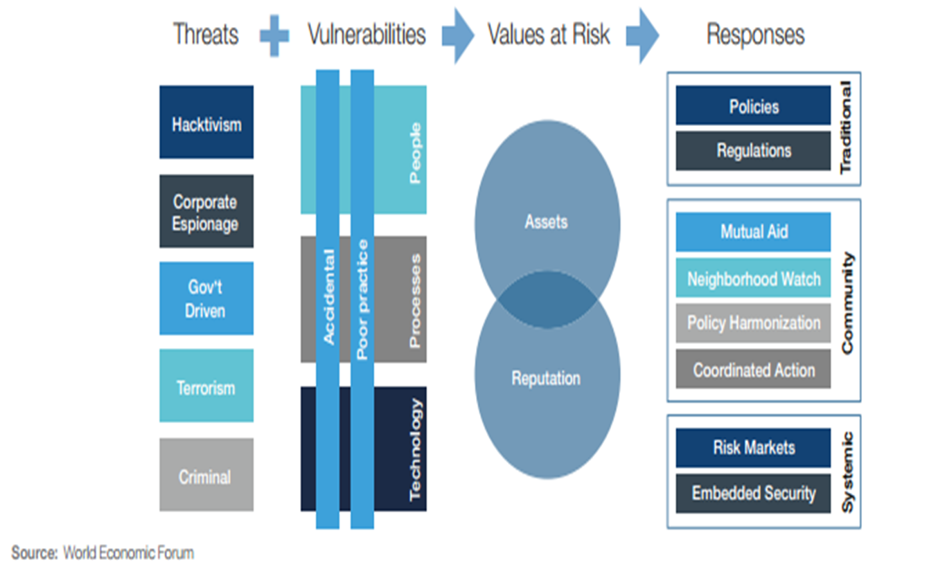
Framework for Cyber Threats and Responses
Source: World Economic Forum, 2012

Slide 29
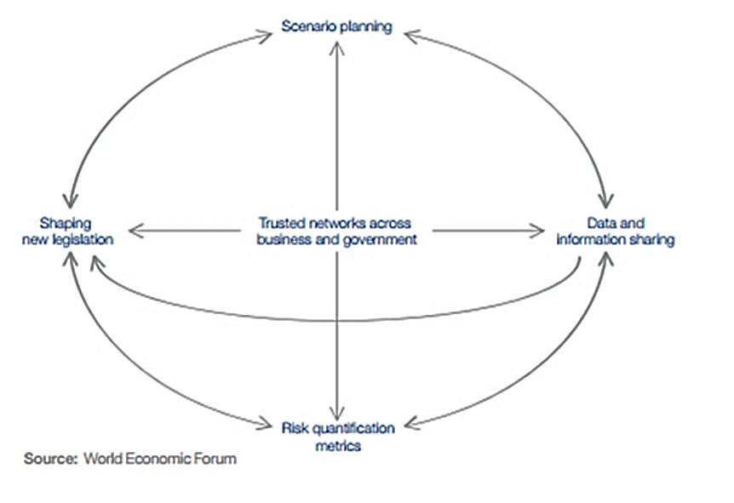
Networks of Mitigation Strategies
2012

Slide 30
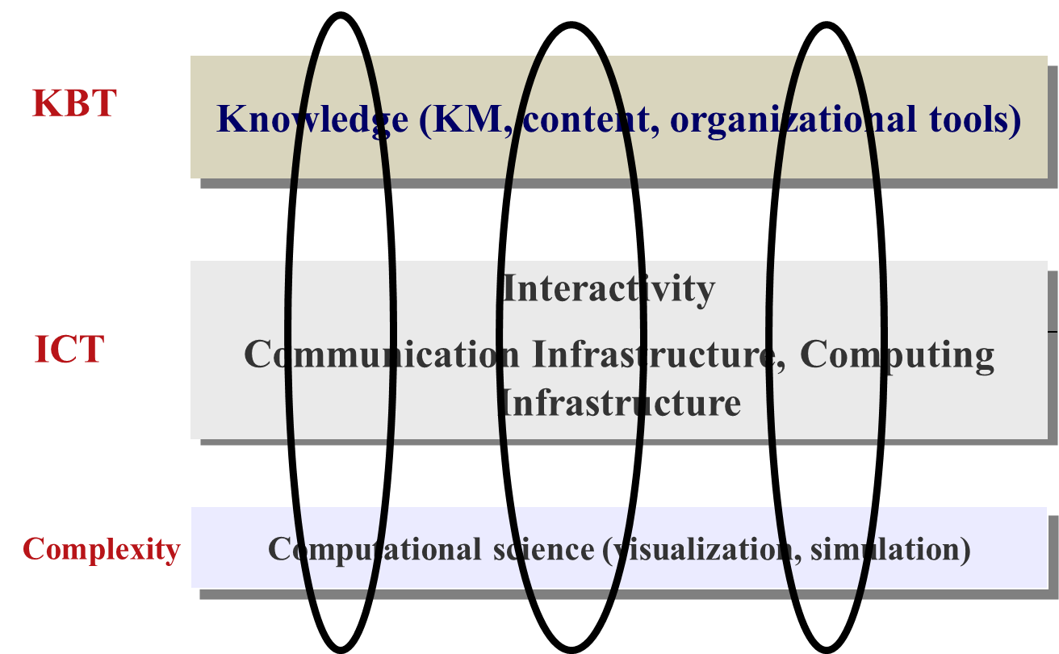
Binding three layers
Source: EC ICT Framework, 2005

Slide 31
WEB SCIENCE & HUMAN-COMPUTER INTERACTION
Source: Association for Computing Machinery Interactions, 2013

Slide 32
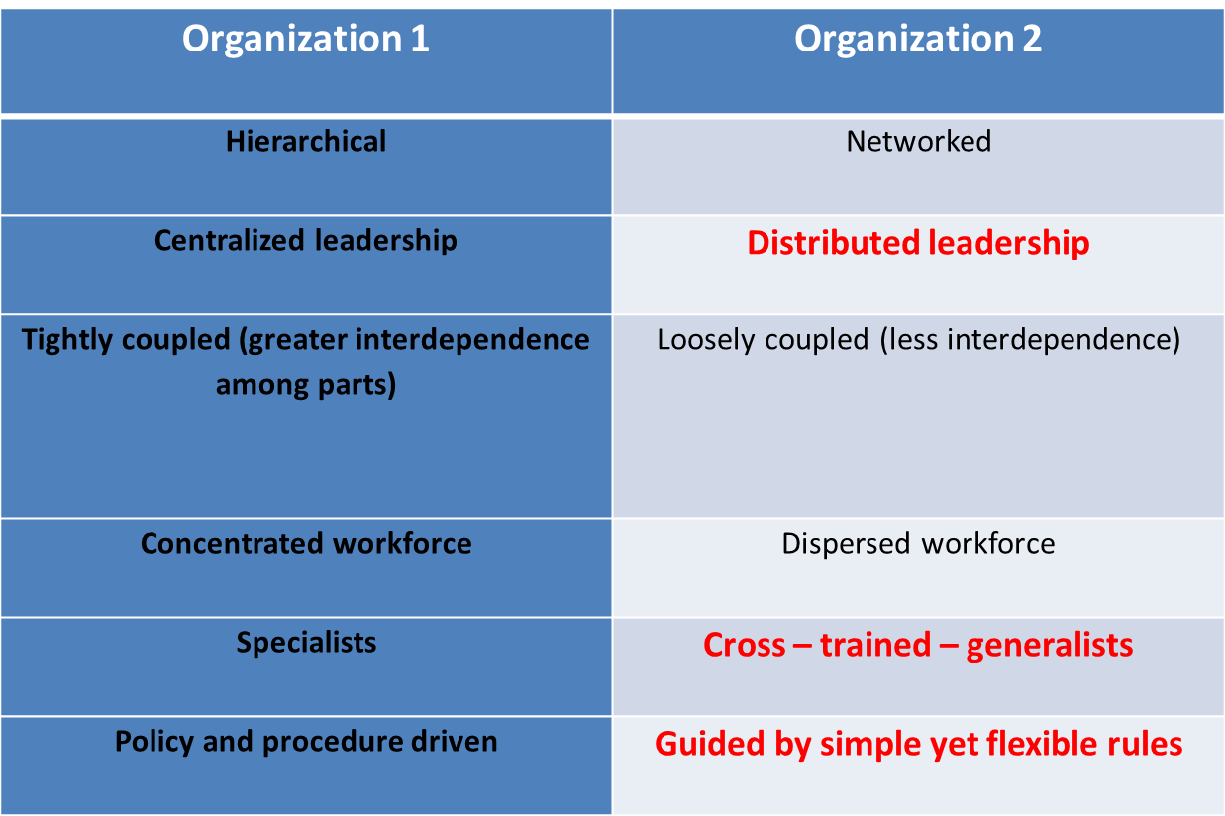
Network Organizations Fare Better in Sustained Crisis
Source: World Economic Forum, 2012

Slide 33
LEADERSHIP COMPETENCIES JOURNEY
Source: Kelner and Patrick, 2010

Slide 34
LEADERSHIP, STRATEGY & EXECUTION
Source: Tozer, 2010

Slide 35
THE CASCADE MANAGEMENT OF COMPLEXITY
Source: Tozer, 2010

Slide 36
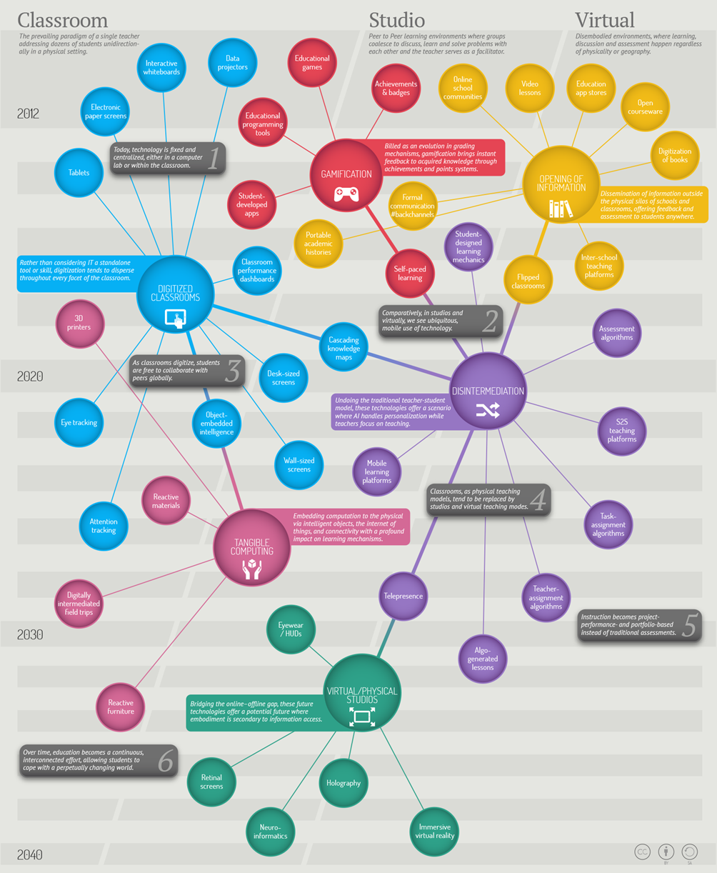
Source: United States Department of Labor: Futurework - Trends and Challenges for Work in the 21st Century (The vision of the future)

Slide 37
Thank you for your attention

