Slide 1
Middle East MIDEA & INFORMATION LITERACY IN THE DIGITAL AGE
Mohamed El-Guindy
TV Presenter & ICT Expert
UNESCO IFAP International Conference on Media and Information Literacy for Building Culture of Open Government (6 – 10 June 2016, Russian Federation)

Slide 2
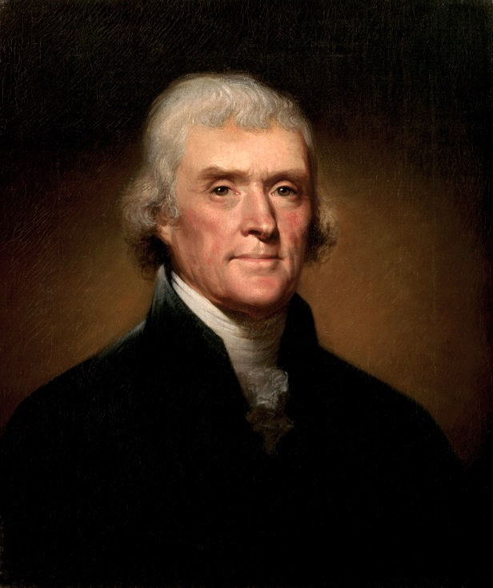
Information & Democracy
“Information is the currency of democracy”
In 1976, U.S. Representative Major Robert Owens tied information literacy to democracy, stated:
“Information literacy is needed to guarantee the survival of democratic institutions.
All men are created equal but voters with
information resources are in a position to
make more intelligent decisions than
citizens who are information illiterates”.
Thomas Jefferson

Slide 3
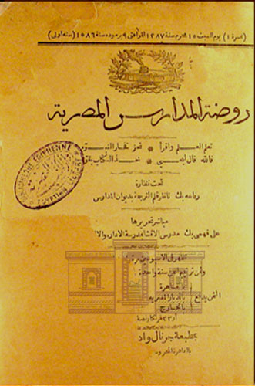
Media & Information Literacy in Egypt
Media literacy within Egyptian schools started in the 19th century
In April 1870, Department of Education launched the first school newspaper called “Rawdat Al Madaress Al Masriya”
One of the pioneering works of Ali Pasha Mubarak
Recently:
There is no Media literacy subjects taught in schools in formal way
There is lack of MIL in Egypt
www.darelkotob.gov.eg

Slide 4
Egypt in the Digital Age
Data is the new oil
Science, technology and information will shape the 21st century
Number of online Egyptian citizens is increasing rapidly
94.1 million
0.5 million
Mobile subscriptions from Jan to Feb. 2016
94.6 million
26.2 million
7 million
Internet users from Jan to Feb. 2016
33.2 million

Slide 5
Egypt in the Digital Age
19.7 million
People access the internet via mobile devices
25.7 million
From Jan. to Feb. 2016
30% growth rate
Facebook is the most used app on smart devices followed by WhatsApp messenger.
The internet created new channel for human connection and social change
It also played a role in Arab uprisings and protests…

Slide 6
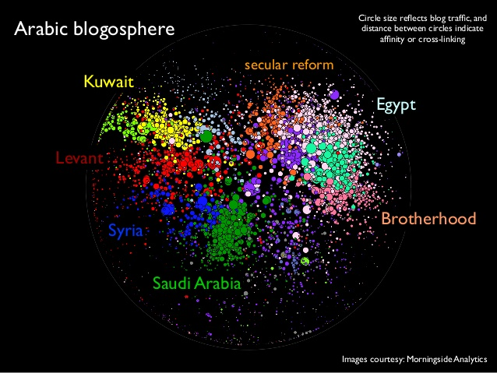
The Rise of Citizen Journalism
In 2003, the war got underway in Iraq
Many blogs written in English started to surface
Egyptian bloggers started to use blogs as a “weapon of opposition” in 2005

Slide 7
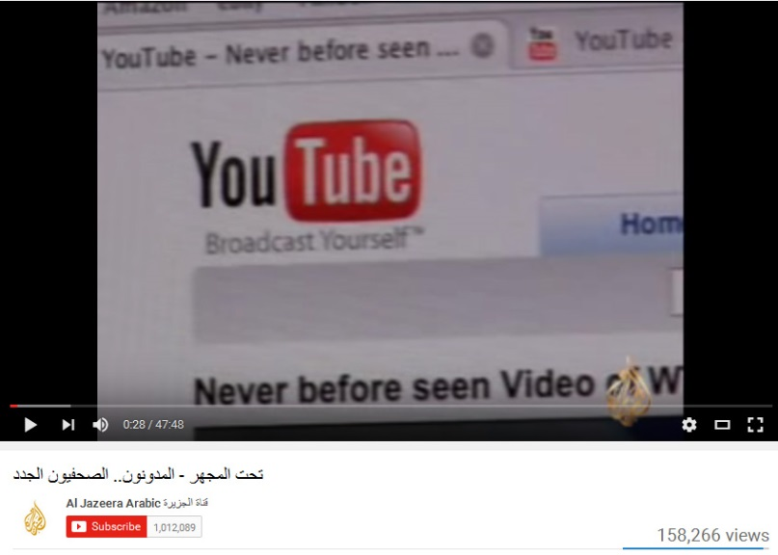
The Rise of Citizen Journalism
Al Jazeera framed Egyptian bloggers in two documentaries (2005 and 2008)
Increased awareness about blogging and its political impact
Problems with citizen journalism in Egypt:
No formal journalistic training
Lack of awareness on role of media in transparency and accountability
Always, the voice of “opposition”
Al Jazeera documentary, Bloggers, Opposition and a New Voice

Slide 8
From Al Jazeera Effect to Social Media Effect
Do social networks and the internet played crucial role in the Arab Spring, and to what extent?
“social media was inconsequential and didn’t play any role in the uprising”

Slide 9
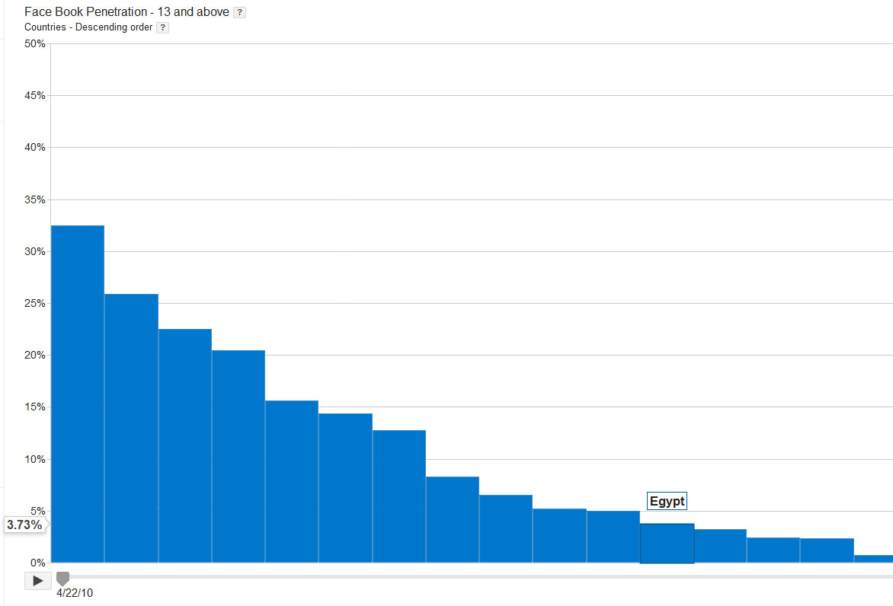
From Al Jazeera Effect to Social Media Effect
Egypt’s Facebook penetration was about 3.73 in April 2010
3.3 million users
In 2010 (Spot on PR)
9 million users
In 2011
(Egypt ICT)
Mohammed Bin Rashid School of Government, Arab Media Report (2010)

Slide 10
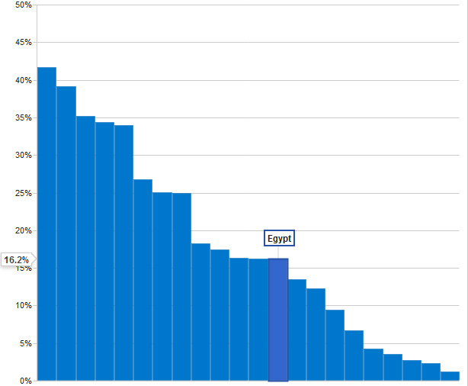
From Al Jazeera Effect to Social Media Effect
Egypt’s Facebook penetration was about 16.2 in 2013
27 million users
In 2015 (Internet World Stats)
28 million users
In 2016
(eMarketing Egypt)
Number of users increased after uprising
Mohammed Bin Rashid School of Government, Arab Media Report (2013)

Slide 11
From Al Jazeera Effect to Social Media Effect
TV still number one source for news in Egypt
Arabic is the main language to access online information
98% Watching TV
22% using the internet
Northwestern University (2013)

Slide 12
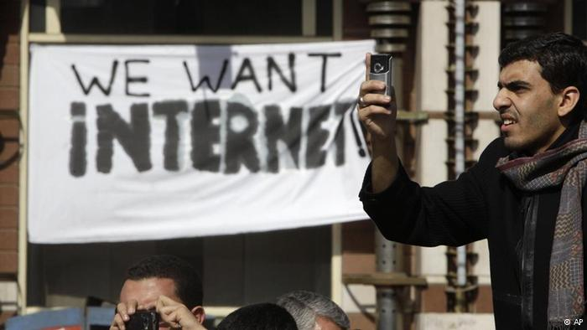
From Al Jazeera Effect to Social Media Effect
Jared Cohen Interview by Steven Levy
Why do people connect between the Arab Spring and Social Media?
AP
FORA.TV, YouTube (July 2011)
Notes:
Director of Google Ideas and Member of the Secretary of State's Policy Planning Staff from 2006-2010

Slide 13
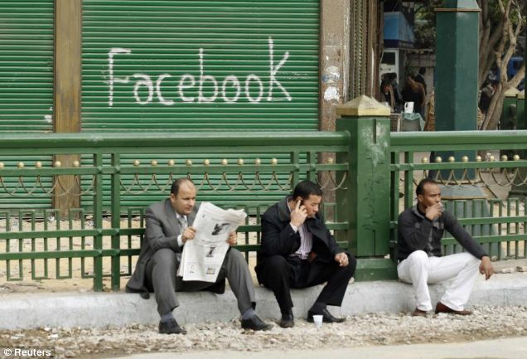
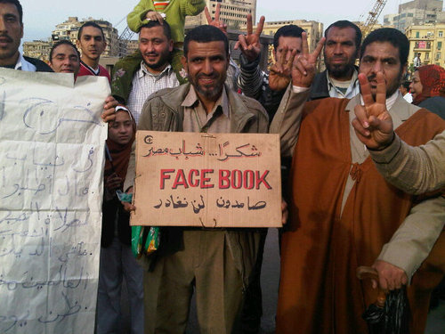
From Al Jazeera Effect to Social Media Effect
Simple answer is: traditional media effect
Al Jazeera Effect…
© Reuters
Notes:
Director of Google Ideas and Member of the Secretary of State's Policy Planning Staff from 2006-2010

Slide 14
From Al Jazeera Effect to Social Media Effect
Framing of social media by Al Jazeera during the Arab Spring
Broadcast Monitoring System (BMS)
Creates a transcript and archive of broadcasts
Mentioned 17 times
15 video clips
Mentioned 31 times
16 video clips
Heidi A. Campbell and Diana Hawk
Notes:
Online Journal of the Virtual Middle East

Slide 15
From Al Jazeera Effect to Social Media Effect
Traditional media still strong in the Middle East
Most TV channels turned to social networks for contents
It amplifies the messages from social media
Social media is influencing traditional media
“Technology did not create revolutions on streets but created a revolution in media”

Slide 16
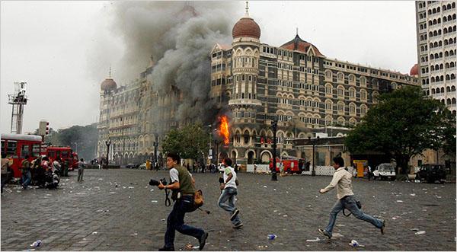
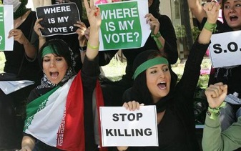
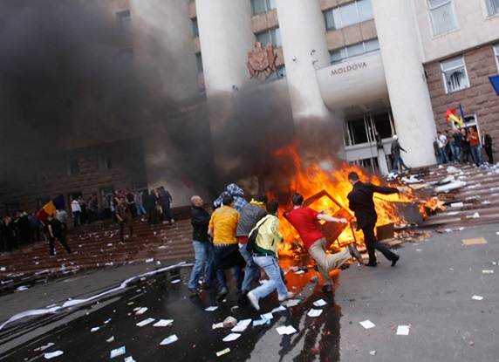
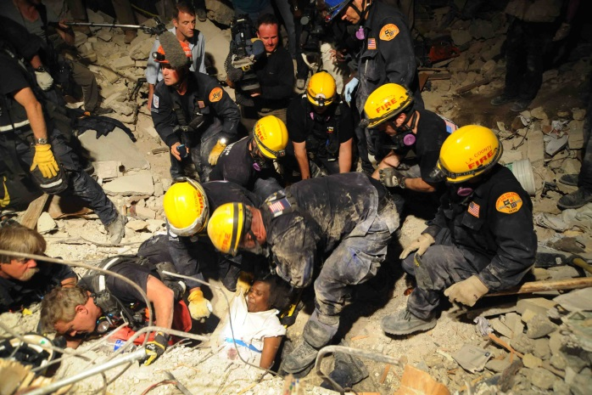
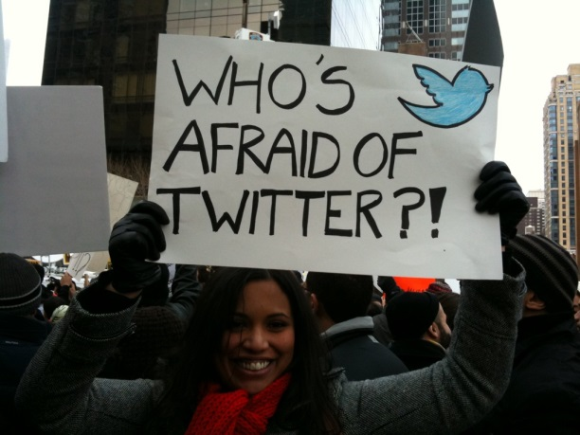
From Al Jazeera Effect to Social Media Effect
Twitter and news coverage for major events
Mumbai (2008) Arko Datta/Reuters
Iranian protests 2009: Photo: AFP
Moldova Civic Unrest 2009 (Photo wired.com)
Haiti Earthquake 2010: US Navy
Arab Uprising

Slide 17
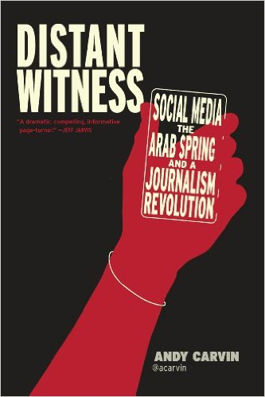
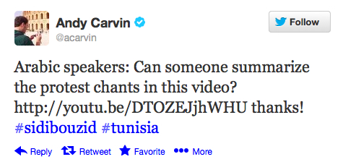
From Al Jazeera Effect to Social Media Effect
For Andy, Twitter become a platform for
Crowdsourcing journalism
Alternative reporting
Real-time verification machine

Slide 18
Rumors, Misinformation & New Media
Lack of media & information literacy
Lack of transparency
Lack of knowledge
Socio-political issues
Crated fertile environment for rumors and false information
The case of EgyptAir flight MS804 (19th May 2016)
Dropped off the radar screens and crashed into the sea
Photo: CNBC

Slide 19
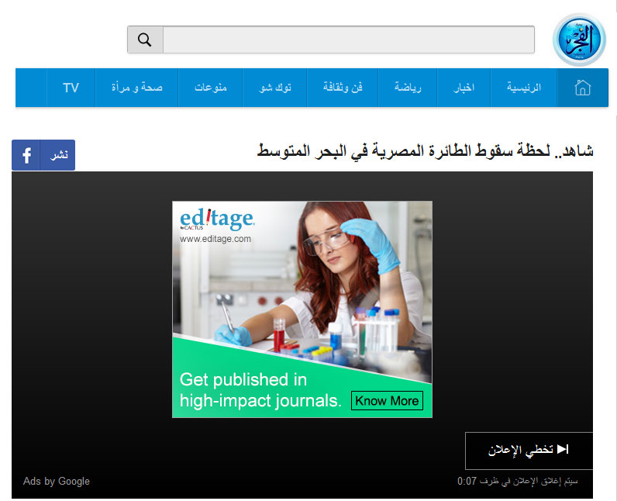
Rumors, Misinformation & New Media
Publish first, verify later!
Watch…Crash of the Egyptian plane in the Mediterranean
Google AdSense
Newspapers used unverified stories to generate online traffic
Elfagr Newspaper, 19 May 2016
Notes:
Director of Google Ideas and Member of the Secretary of State's Policy Planning Staff from 2006-2010

Slide 20
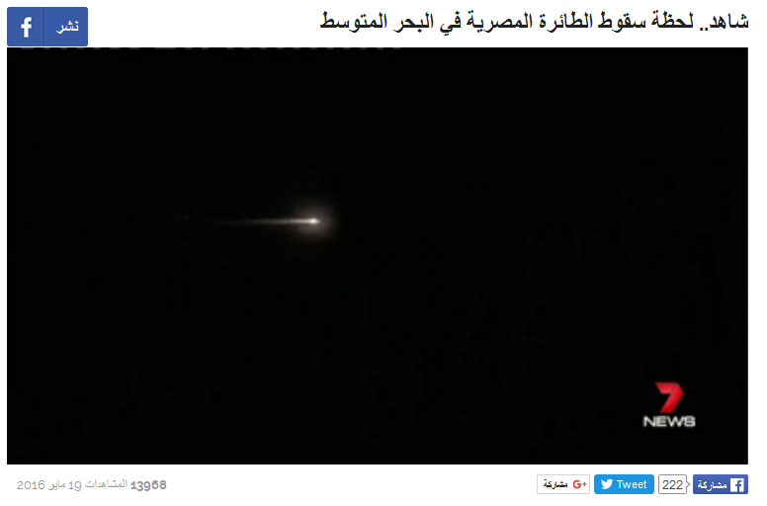
Rumors, Misinformation & New Media
Newspapers used unverified stories to generate online traffic
Shared 222 times as of 19 May 2016 from this website alone!
Video got 13966 views as of 19 May 2016
Elfagr Newspaper, 19 May 2016
Notes:
Director of Google Ideas and Member of the Secretary of State's Policy Planning Staff from 2006-2010

Slide 21
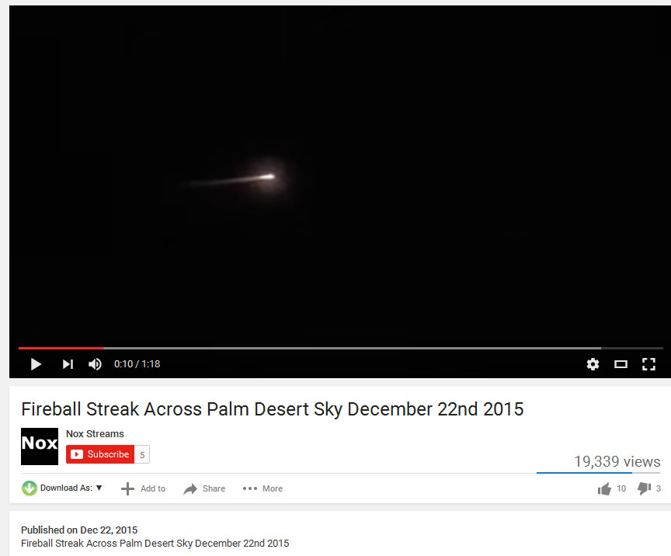
Rumors, Misinformation & New Media
The real story is different!
Video dated Dec. 22, 2015
Notes:
Director of Google Ideas and Member of the Secretary of State's Policy Planning Staff from 2006-2010

Slide 22
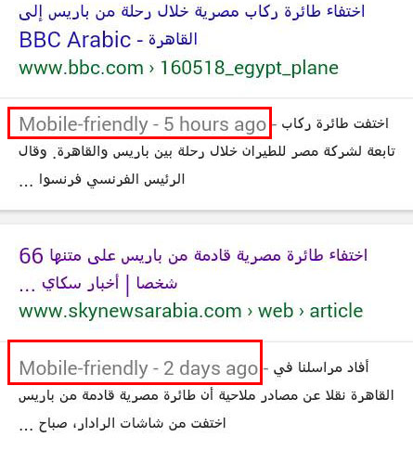
Rumors, Misinformation & New Media
Not only rumors, but also conspiracy theories..!
Most social media users believed that Sky news Arabia was a conspirator!
They published EgyptAir flight crash two days before the incident!
Lack of knowledge, lack of media and information literacy, lack of digital literacy etc.
Notes:
Director of Google Ideas and Member of the Secretary of State's Policy Planning Staff from 2006-2010

Slide 23
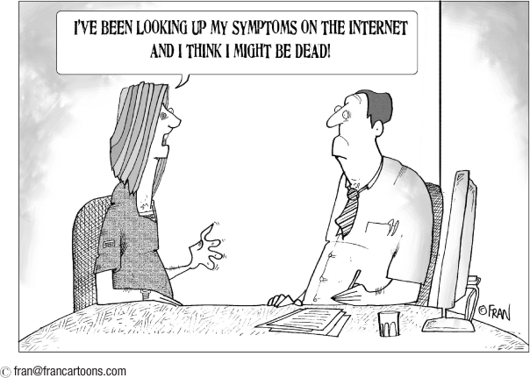
Rumors, Misinformation & New Media
Google it, I found it on google!
© Francartoons.com
Notes:
Director of Google Ideas and Member of the Secretary of State's Policy Planning Staff from 2006-2010

Slide 24
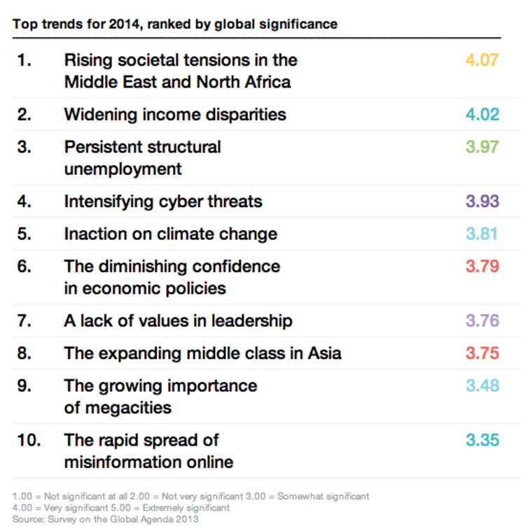
Rumors, Misinformation & New Media
People with low level of critical thinking will accept rumors
As the number of believers grow, others will conclude that so many people cannot be wrong.
Misinformation online is Global phenomenon
WEF 2014 top trends
Notes:
Director of Google Ideas and Member of the Secretary of State's Policy Planning Staff from 2006-2010

Slide 25
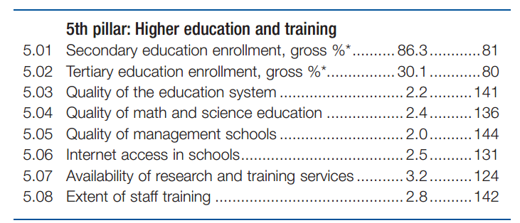
Conclusion
Educating people is the best method…
It is not education per se but the quality of education that matters
Quality of education in Egypt is of concern as it scored low
141/144
WEF Global Competiveness Report 2014- 2015
Notes:
Director of Google Ideas and Member of the Secretary of State's Policy Planning Staff from 2006-2010

Slide 26
Conclusion
Most formal curriculums lack logical evaluation in the essence of scientific methods
Critical thinking activities and strategies should be included
“Every man should have a built-in automatic crap detector operating inside him. It also should have a manual drill and a crank handle in case the machine breaks down”. -Ernst Hemingway
Notes:
Director of Google Ideas and Member of the Secretary of State's Policy Planning Staff from 2006-2010

Slide 27
Conclusion
We live in a convergence era
However, TV still No.1 source for news and entertainment in Egypt
Majority of youth still amateur users of ICT
Number of online users in Egypt will grow immensely within 10 years
Quality MIL education is needed for the digital age
Notes:
Director of Google Ideas and Member of the Secretary of State's Policy Planning Staff from 2006-2010

Slide 28
Conclusion
Educating people won’t solve everything…
Technology is moving faster than laws and regulations
Technology and new media influence democracy
Technology won’t make government accountable and transparent by default
Openness and transparency strategies are needed to cope with the ever-changing world of information
Notes:
Director of Google Ideas and Member of the Secretary of State's Policy Planning Staff from 2006-2010

Slide 29
Thank You!
Mohamed El-Guindy
TV Presenter & ICT Expert
Contact: elguindy@bcs.org | elguindy@ieee.org Please refer to the research paper for more details
UNESCO IFAP International Conference on Media and Information Literacy for Building Culture of Open Government (6 – 10 June 2016, Russian Federation)
Notes:
Director of Google Ideas and Member of the Secretary of State's Policy Planning Staff from 2006-2010

